Slide 1
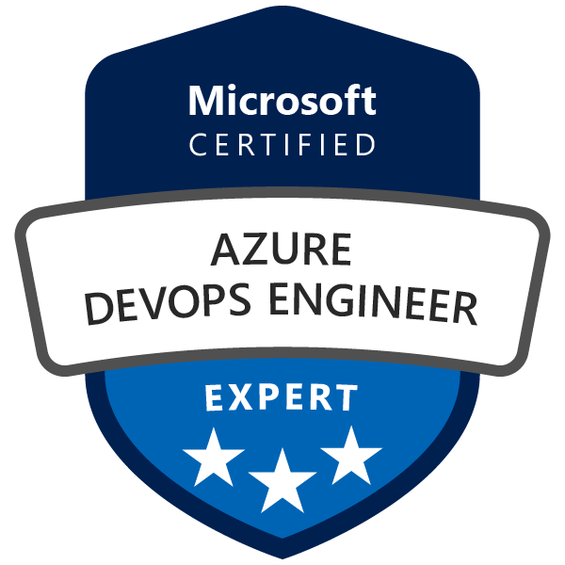
Exam AZ-400: Microsoft Azure DevOps Solutions Crash Course
Tim Warner @TechTrainerTim

Slide 2

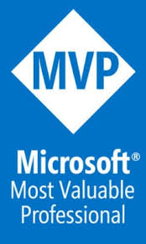
Tim Warner
Based in Nashville, TN, US
MCT, MVP
Twitter: @TechTrainerTim
Badge: timw.info

Slide 3
Course Materials
timw.info/az400

Slide 4
Session 1 of 2 Learning Goals
Understand DevOps and Azure DevOps
Source Code Control
Pipeline Creation
Build
Release
Pipeline Configuration
Azure Key Vault
Code Analysis
AZ-400 Exam Prep

Slide 5
Session 2 of 2 Learning Goals
Infrastructure and configuration management
Continuous monitoring/site reliability engineering
Dependency management
System feedback mechanisms
AZ-400 exam strategy, continued

Slide 6
Setting Expectations
This is a six-hour "crash course"
Please plan to review these materials more than once
Five-minute break at midpoint
Please ask/answer questions and provide feedback in the Q/A panel, not the group chat
I'll post outstanding questions/answers to my Twitter feed: @TechTrainerTim

Slide 7

Session Recordings

Slide 8
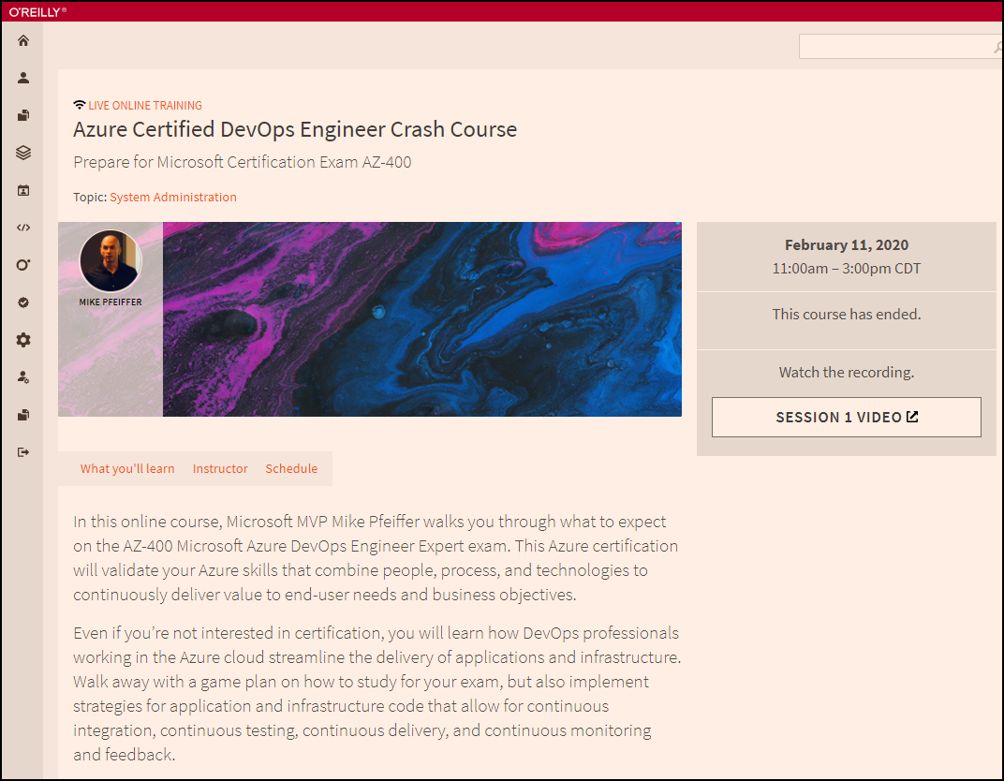
Session Recordings

Slide 9

Session Recordings

Slide 10
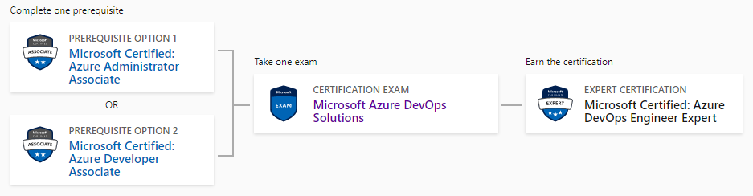
DevOps Engineer Expert Certification
AZ-104
AZ-400
AZ-204

Slide 11
Tim's Suggested Certification Strategy
Clear Exam AZ-104, Microsoft Azure Administrator, first
You need those core infrastructure skills
JSON, PowerShell
Monitoring
Then clear Exam AZ-400
AZ-400 is about development principles, not programming
This course gives you the dev foundations
You need to already have the ops foundations

Slide 12
DevOps and Azure DevOps

Slide 13
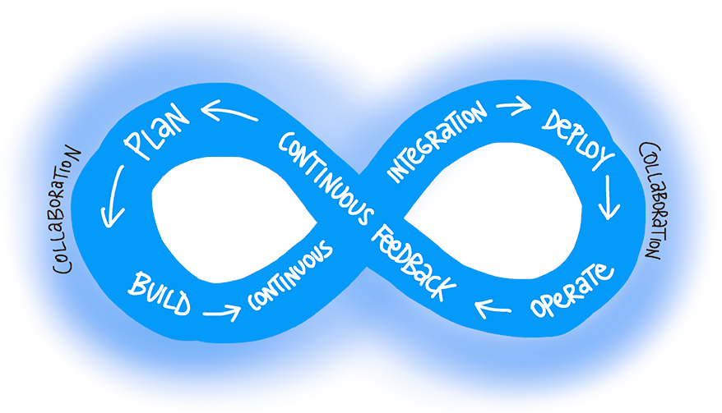
DevOps
"The union of people, process, and products to enable continuous delivery of value to our end users"
timw.info/dodef

Slide 14
DevOps: Personas
Developer
Operations
Q/A
Security
Compliance

Slide 15
Source Control in Azure DevOps

Slide 16
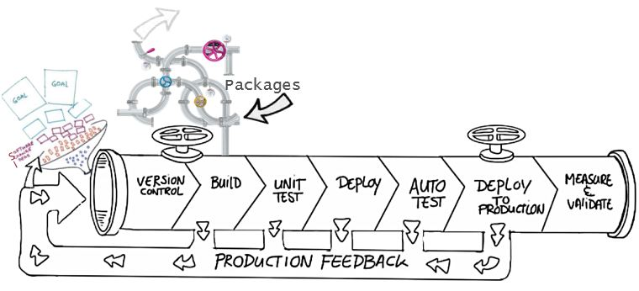
Source Control Benefits
Collaboration
Change history
Task automation

Slide 17
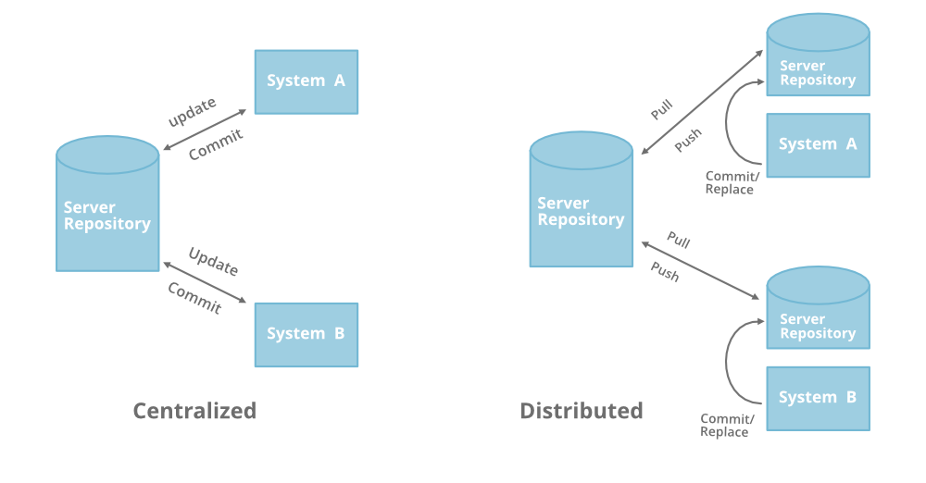
Source Control Types
TFVC
Git
timw.info/g4g

Slide 18
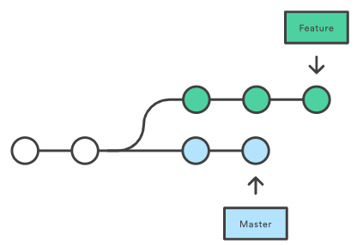
Git: Feature Branch Strategy: Merge vs Rebase

Slide 19
Git: Feature Branch Workflow
Create a branch
Add commits
Open a pull request
Discuss and review your code
Deploy
Merge

Slide 20
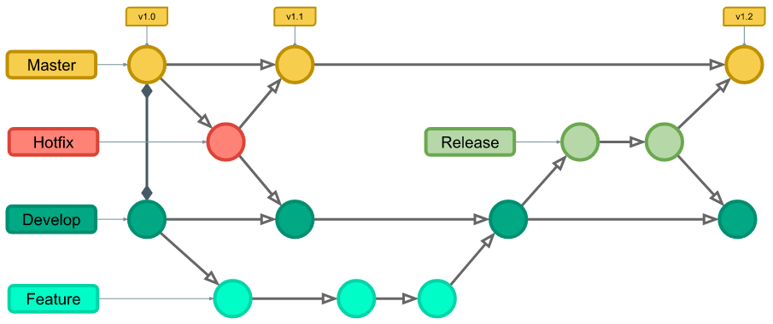
Git: Git Flow Branch Workflow

Slide 21
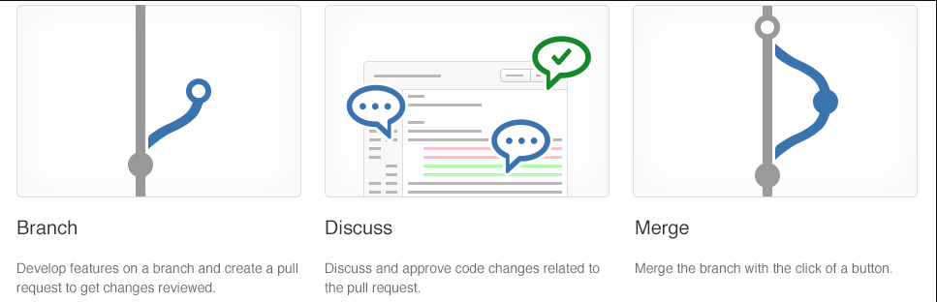
Collaborating with Pull Requests
Pull requests let you tell others about changes
Collaboration using the Shared Repository Model
Review and merge your code in a single collaborative process
Be sure to provide good feedback and protect branches with policies

Slide 22
CI/CD

Slide 23
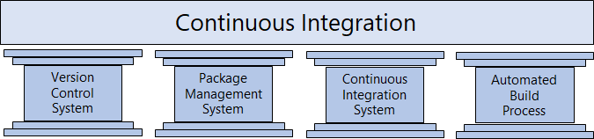
The Four Pillars of Continuous Integration
A Version Control System manages changes to your source code over time.
A Package Management System is used to install, uninstall and manage software packages.
A Continuous Integration System merges all developer working copies to a shared mainline several times a day.
An Automated Build Process creates a software build including compiling, packaging, and running automated tests.
Notes:
Cover the software examples shown in the student materials.

Slide 24
The Concept of Pipelines in DevOps
Build Automation and Continuous Integration
Test Automation
Deployment Automation
Constant, automated change flow into production
Repeatable, reliable and incrementally improving process
Requires infrastructure, this agent hardware has a direct impact on the pipeline's efficiency

Slide 25
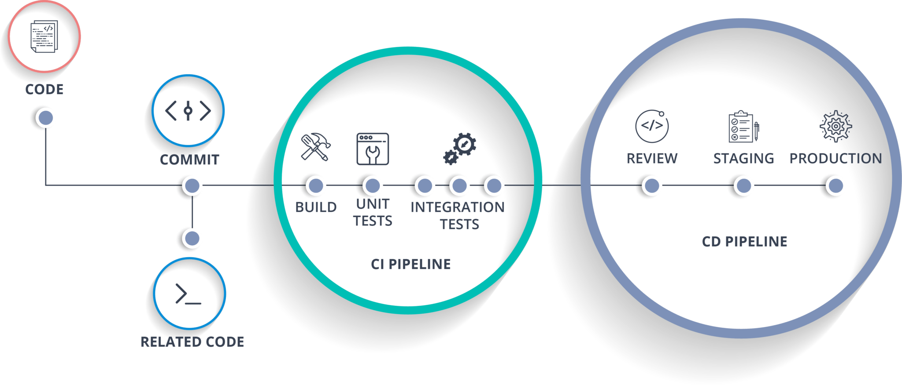
CI/CD Pipelines

Slide 26

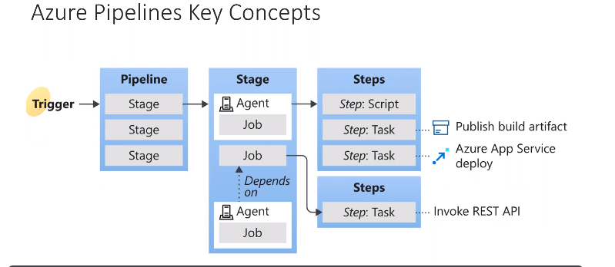
CI/CD Pipelines

Slide 27
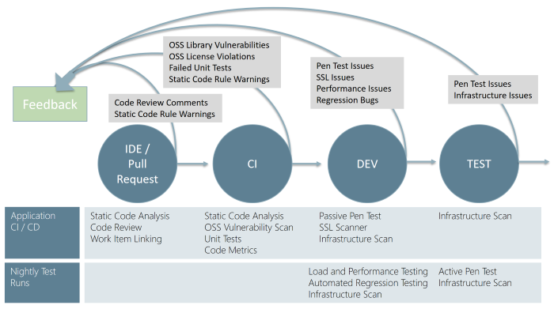
Continuous Security Analysis
"Shift testing left"

Slide 28
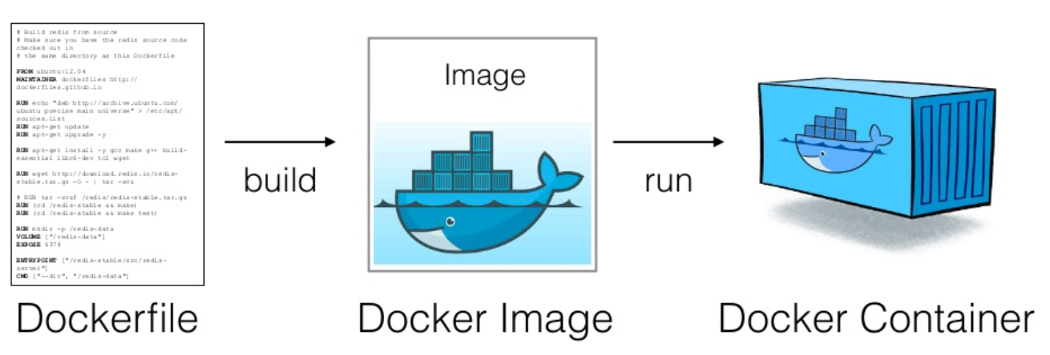
Docker Workflow

Slide 29
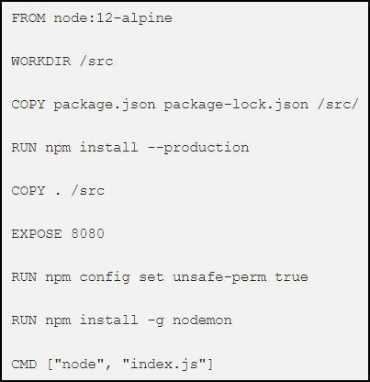
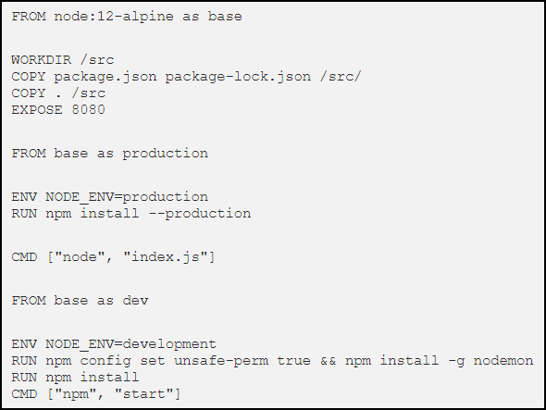
Multi-Stage Docker Builds

Slide 30
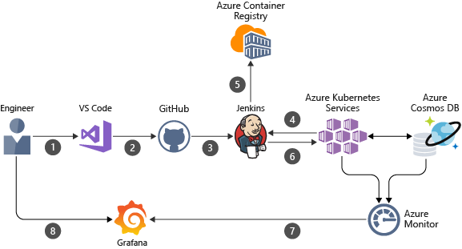
Jenkins Integration

Slide 31
Takeaway Study Points
You won't see SDK languages on your exam (C#, Java, etc)
You will see PowerShell and perhaps some Dockerfile syntax
You will see lots of JSON and YAML

Slide 32
Thank you!
Course materials: timw.info/az400
Twitter: @TechTrainerTim
Work: timw.info/ps
Web: TechTrainerTim.com

Slide 33
Exam AZ-400: Microsoft Azure DevOps Solutions Crash Course
Tim Warner @TechTrainerTim

Slide 34
Course Materials
timw.info/az400

Slide 35
Session 2 of 2 Learning Goals
Sweep up yesterday's "shavings"
Azure Pipelines release gates
Azure Monitor alerts
Infrastructure and application monitoring
Infrastructure as Code / Config Mgmt
Dependency management
Continuous feedback
AZ-400 exam strategy

Slide 36
Content

Slide 37

Azure Monitor
timw.info/azmon

Slide 38

Application Insights
timw.info/appi

Slide 39
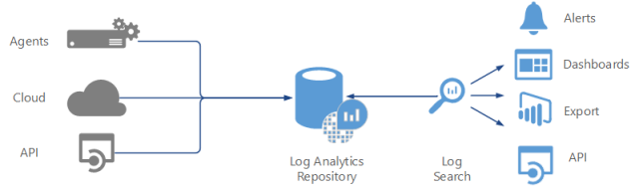
Log Analytics
timw.info/83040

Slide 40
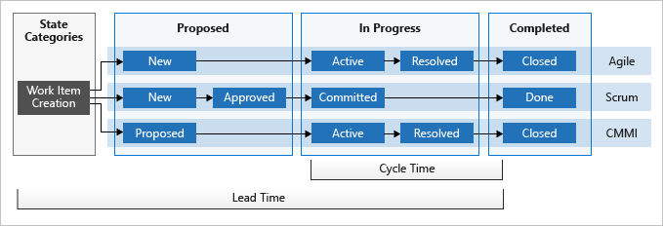
Azure DevOps Dashboards
timw.info/9326c

Slide 41
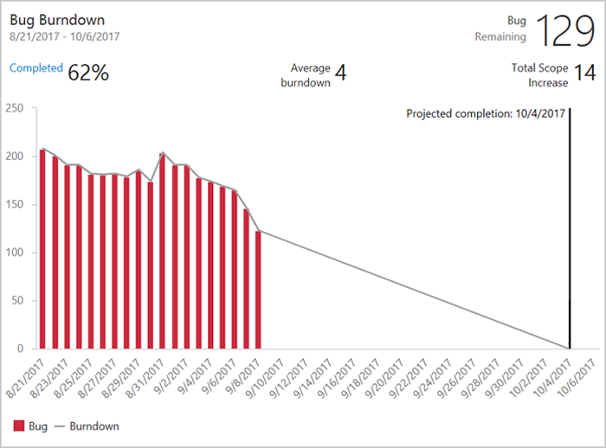
Azure DevOps Dashboards
timw.info/c243a

Slide 42
Tim's Certification Study Pyramid
Interdependence
Content knowledge
Practical application
This crash course
AzureDevOpsLabs.com
AzDo docs
Microsoft Learn
Test-taking skills
WhizLabs
Tim's YouTube

Slide 43
Thank you!
Course materials: timw.info/az400
Twitter: @TechTrainerTim
Work: timw.info/ps
Web: TechTrainerTim.com

Slide 44
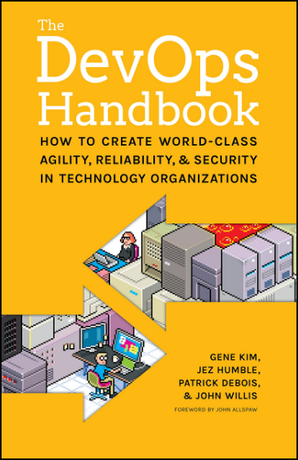
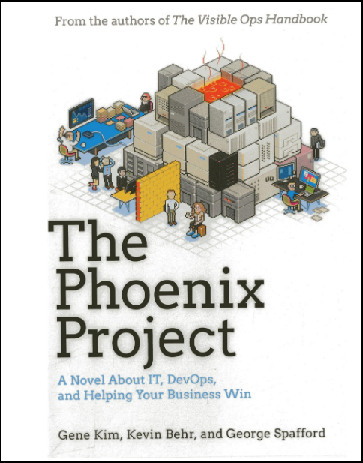
DevOps: Required Reading

Slide 45
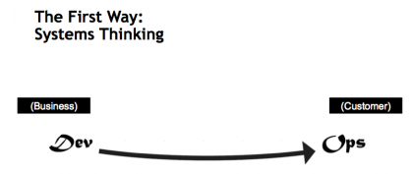
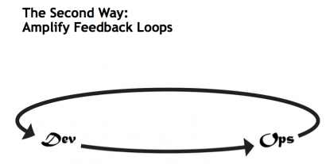
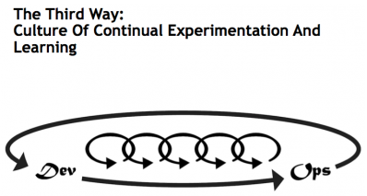
DevOps: The Three Ways
timw.info/ttw

Slide 46
DevOps Engineer Role
DevOps professionals streamline delivery by optimizing practices, improving communications and collaboration, and creating automation. They design and implement strategies for application code and infrastructure that allow for continuous integration, continuous testing, continuous delivery, and continuous monitoring and feedback.
Azure DevOps professionals must be able to design and implement DevOps practices for version control, compliance, infrastructure as code, configuration management, build, release, and testing by using Azure technologies.

Slide 47
Azure DevOps Products
Visual Studio Team Services > Azure DevOps Services
Team Foundation Server > Azure DevOps Server 2019

Slide 48
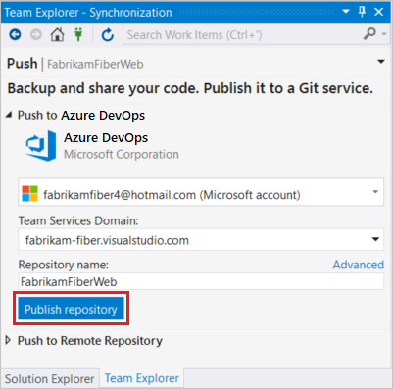
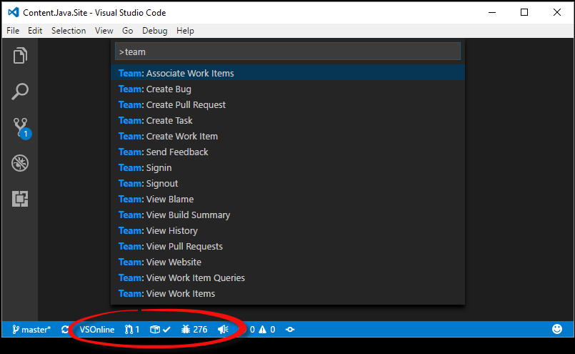
Azure DevOps IDE Extensions

Slide 49
Azure DevOps CLI Extension
az extension add --name azure-devops
$az devops login --organization https://dev.azure.com/contoso
Token:
az devops configure --defaults organization=https://dev.azure.com/contoso project=ContosoWebApp
az devops –h
az pipelines build show --id 1 --open

Slide 50
Start an organization
Open sample project
Create/import repos
Clone/commit/push workflow
Pull request workflow

Slide 51
Build Pipelines

Slide 52
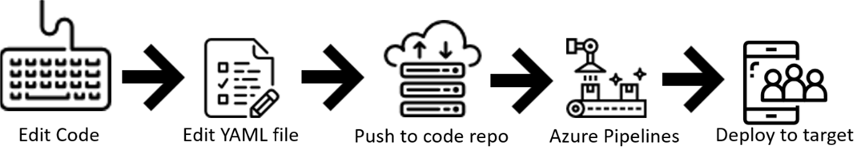
Azure Pipelines and YAML
Configure your pipelines in a YAML file that exists alongside your code
Configure Azure Pipelines to use your Git repo
Edit your azure-pipelines.yml file to define your build
Push your code to your version control repository
Your code is now updated, built, tested, and packaged

Slide 53
Hosted vs Private Agents
You need at least one agent to build or deploy your project
An agent is installable software that runs one build or deployment job at a time
Two types of agents:
Microsoft-hosted agents - Automatically take care of maintenance and upgrades. Each time you run a pipeline, you get a fresh virtual machine. The virtual machine is discarded after one use.
Self-hosted agents – You take care of maintenance and upgrades. Give you more control to install dependent software needed. You can install the agent on Linux, macOS, Windows machines, or even in a Linux Docker container.

Slide 54
Application Settings and Secrets

Slide 55

Key Security Validation Points
timw.info/csv

Slide 56
Integrating Azure Key Vault with Azure Pipeline
Complete the Integrating Azure KeyVault with Azure DevOps. You will learn how to:
Create a key vault, from the Azure portal, to store a MySQL server password
Configure permissions to let a service principal to read the value
Retrieve the password in an Azure pipeline and passed on to subsequent tasks
Notes:
Integrating Azure KeyVault with Azure DevOps - https://www.azuredevopslabs.com/labs/vstsextend/azurekeyvault/

Slide 57
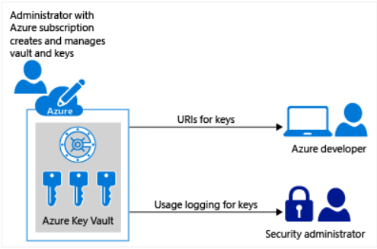
Manage Secrets, Tokens & Certificates
Centralize application secrets
Securely store secrets and keys
Monitor access and use
Simplified administration of application secret
Integrate with other Azure services

Slide 58
Code Quality and Security

Slide 59
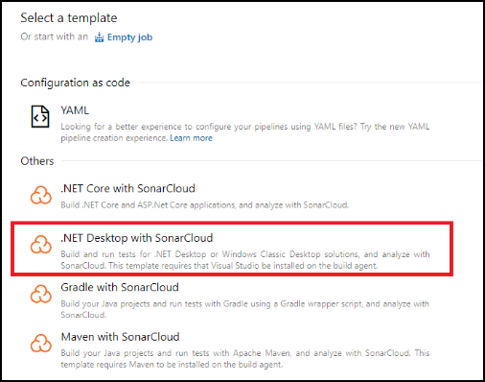
SonarCloud
Technical debt – measure between the codebase’s current state and an optimal state
SonarCloud performs Static code analysis
Bug detection
Security vuln ID
Code smells
SonarQube is the on-premises product
Azure DevOps Server 2019

Slide 60
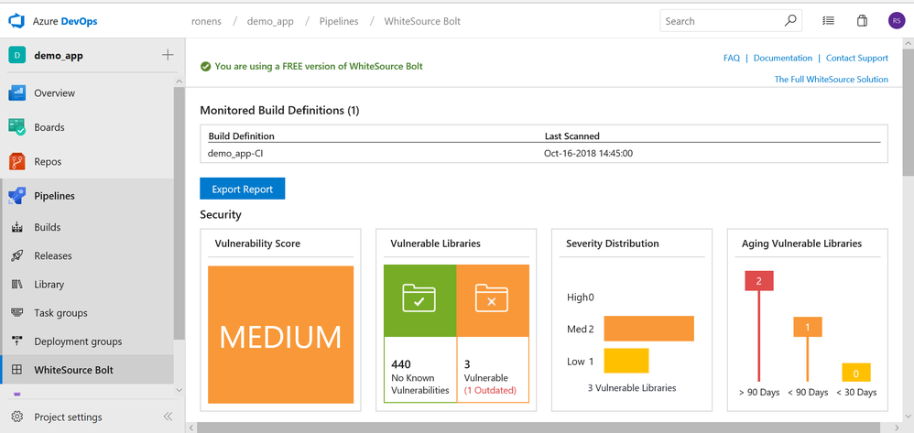
WhiteSource Bolt
Notes:
Managing Open-source security and license with WhiteSource - https://www.azuredevopslabs.com/labs/vstsextend/WhiteSource/
✔️ Note that you must have already completed the prerequisite labs in the Welcome section.

Slide 61
Container Build Strategy

Slide 62
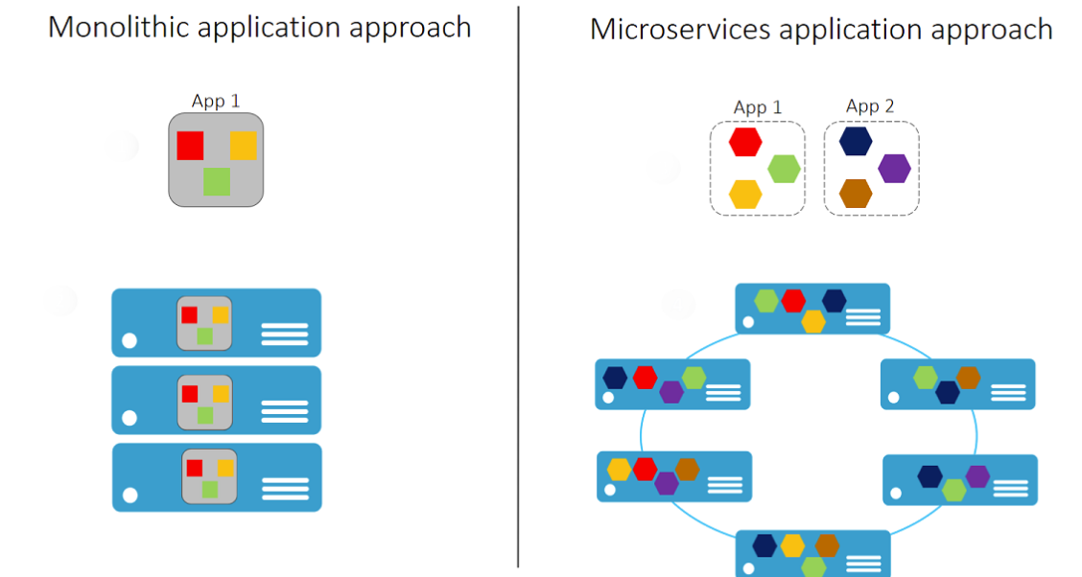
Microservices and Containers
✔️ With Microservices every part of the application is deployed as a fully self-contained component

Slide 63
Dockerfile Core Concepts
FROM ubuntu
LABEL maintainer="greglow@contoso.com"
ADD appsetup /
RUN /bin/bash -c 'source $HOME/.bashrc; \
echo $HOME'
CMD ["echo", "Hello World from within the container"]
✔️ Dockerfiles are text files that contain the commands needed by docker build to assemble an image
Notes:
For more information, you can see: Dockerfile reference - https://docs.docker.com/engine/reference/builder/

Slide 64
Optimizing Docker Container Builds
Keep the image size as small as possible
Layers are additional instructions added to the Dockerfile
Each FROM instruction starts a new stage
The stages are numbered in order, starting with stage 0
Stages are named using an AS clause
Naming stages lets you build them separately
Notes:
The Demonstration: Adding Docker Support to an Existing App explains the code sample in the student guide.

Slide 65
Mobile DevOps

Slide 66
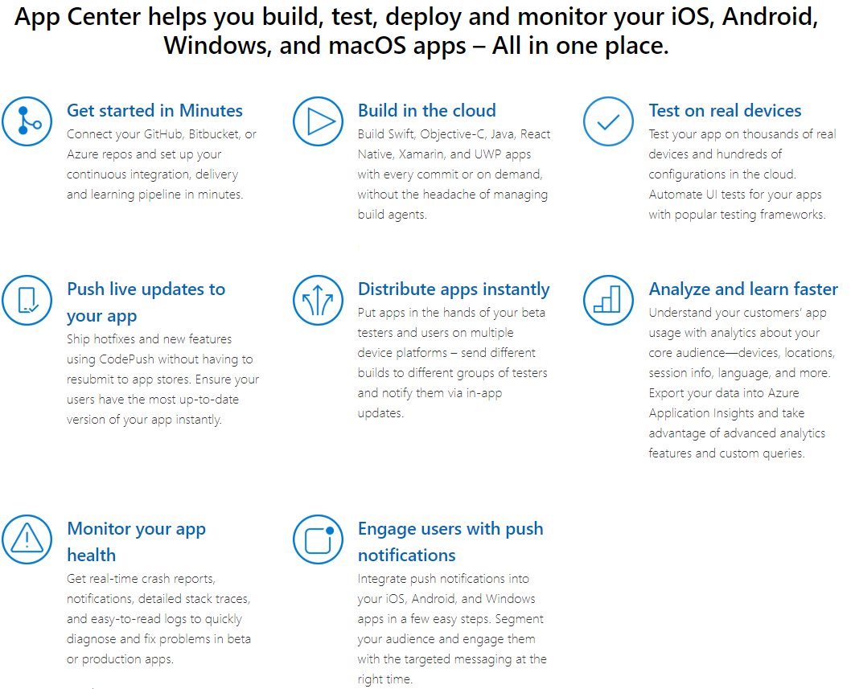
Visual Studio App Center
App Center brings together multiple services into an integrated cloud solution
Developers use App Center to Build, Test, and Distribute applications
Once the app's deployed, developers can monitor the status and usage of the app

Slide 67
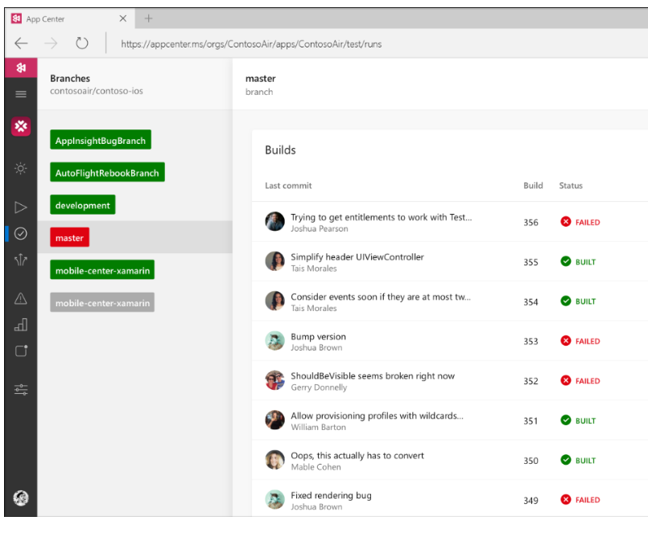
Continuous Integration in Minutes
Build apps more frequently and faster- iOS, Android, Windows, and macOS
Connect to your GitHub, Bitbucket or Azure repos and build your apps
Create an installable app package - GitHub, or Git repos on Bitbucket and Azure DevOps

Slide 68
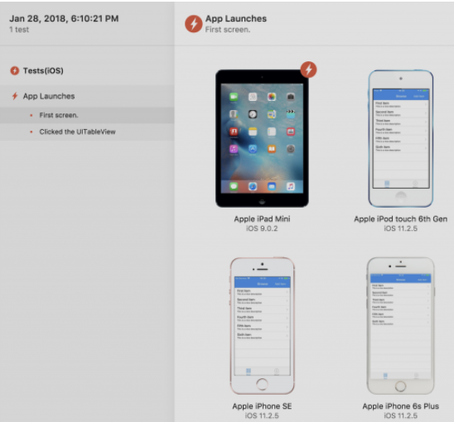
Run UI Tests
Vs Appium / Selenium
Upload your test suite after completing a build
Generate a test upload shell command, add it to your app’s repo
When your test code finishes executing, a detailed report will appear in the App Center Test
App Center provides device logs, test framework logs, and the line in which the failure occurred

Slide 69
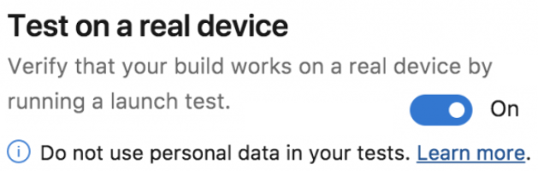
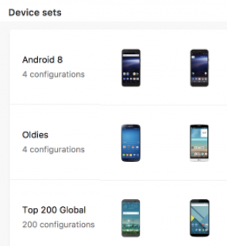
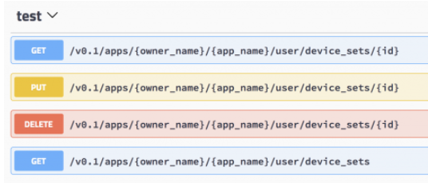
App Center Distribution
Developer tool to release application binaries to their end user devices
Distribute packages for iOS, Android, UWP, and macOS
Named Device Sets
API App Center Tests

Slide 70
Release Infrastructure and Continuous Delivery

Slide 71
The Eight Principles of Continuous Delivery
The process for releasing/deploying software MUST be repeatable and reliable.
Automate everything!
If somethings difficult or painful, do it more often.
Keep everything in source control.
Done means “released”.
Build quality in!
Everybody has responsibility for the release process.
Improve continuously.

Slide 72
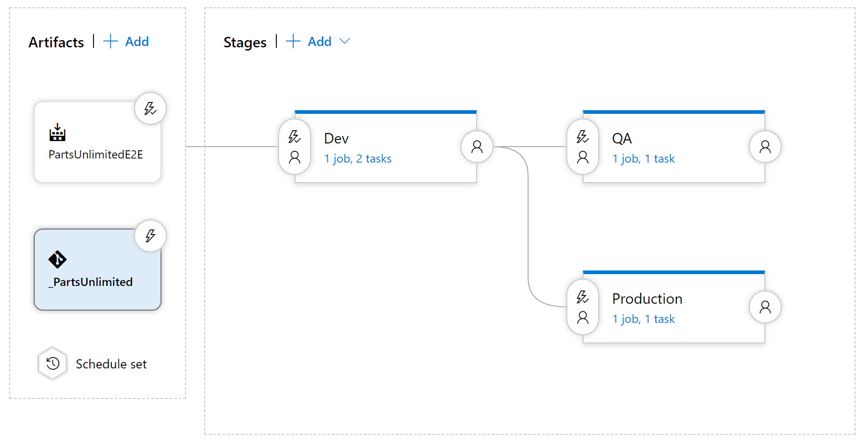
Components in a release pipeline

Slide 73
Delivery cadence - three types of triggers
Continuous Deployment Trigger
Scheduled Trigger
Manual Trigger

Slide 74
Release Approvals
Release approvals are not to control *how*, but control *if* you want to deliver multiple times a day.
Manual Approvals help in building trust about the automated release process

Slide 75
Release Gate Examples
Incident and issues management
Notification of users by integration with collaboration systems
Quality validation
Security scan on artifacts
User experience relative to baseline
Change management
Infrastructure health

Slide 76
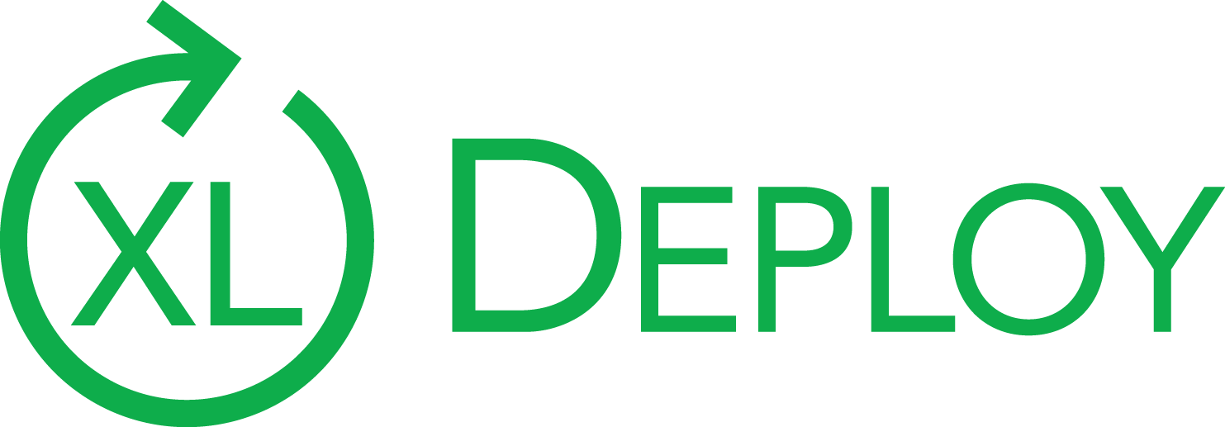

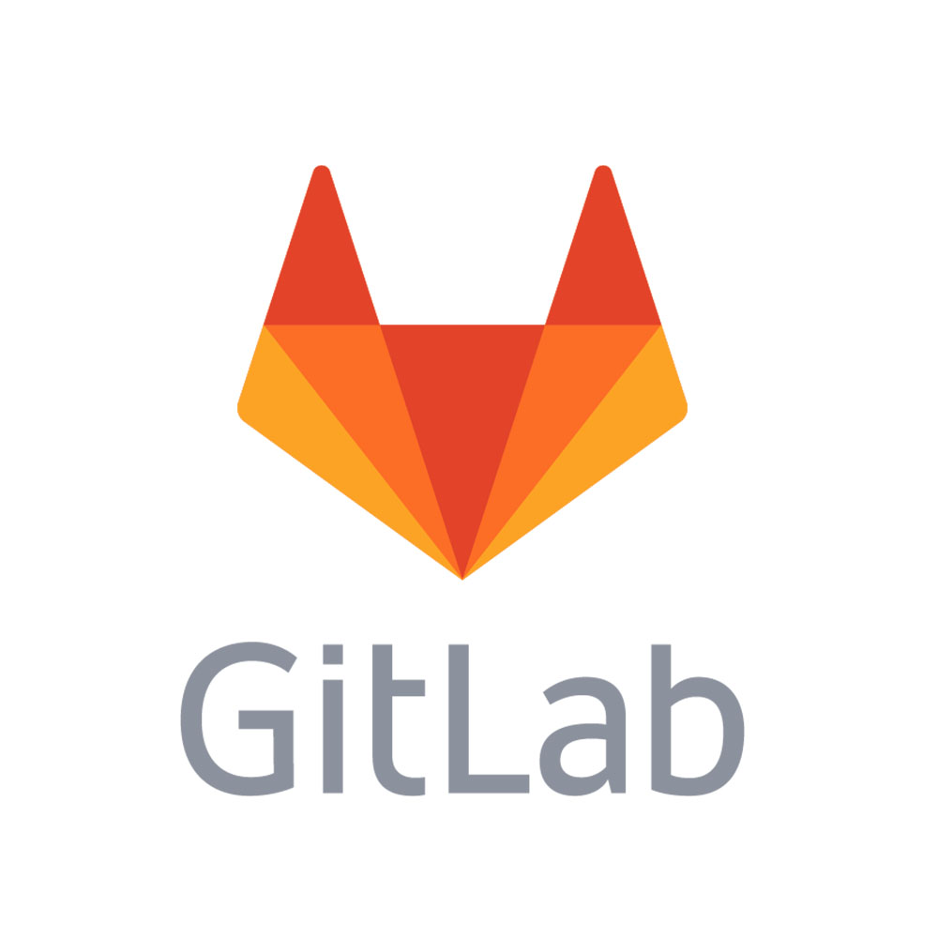
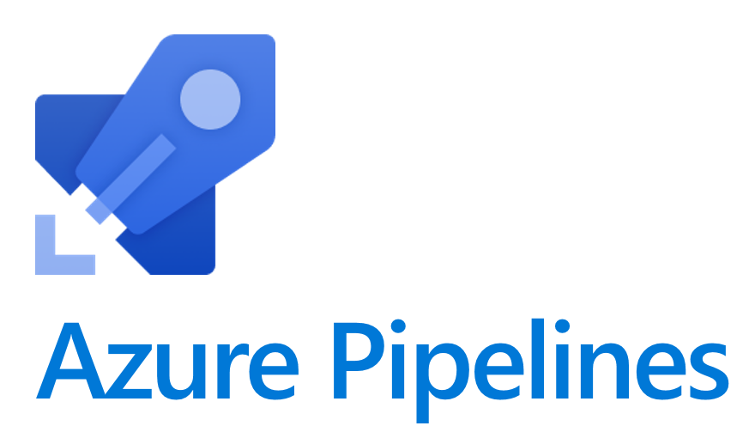
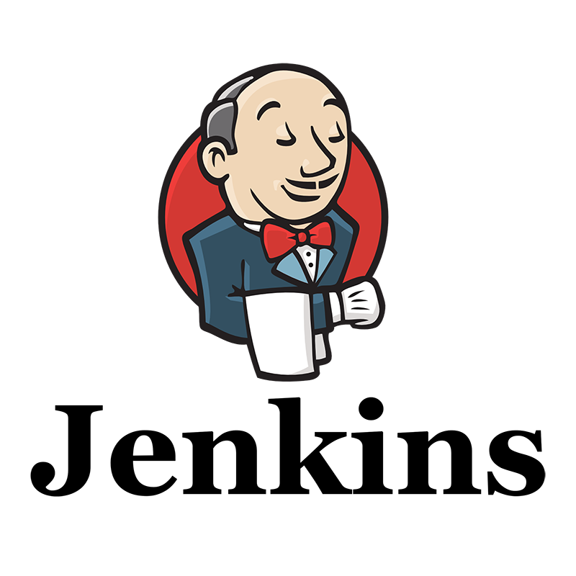
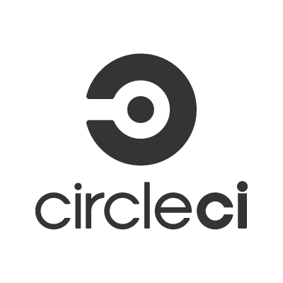
Release Management Tools
Jenkins
Circle CI
Azure DevOps Pipelines
GitLab Pipelines
Atlassian Bamboo
XL Deploy/XL Release

Slide 77
Create a Release Pipeline

Slide 78
Definitions and Glossary
Term | Description | Synonym
Stage | an isolated and independent target for deployment | Environment
Job | A phase in the release pipeline that can run simultaneously with other phases on different Operating Systems | Phases
Agent | The program that runs the build or release
Build & Release Task | Tasks are units of executable code used to perform designated actions in a specified order. | Action, Plugin, App
Release pipeline | The process that runs when deploying an artifact. Including triggers, approvals and gates | release process, pipeline, release definition
CI/CD | Continuous Integration / Continuous Deployment
Release Gate | An automated check that approves the continuation | Quality Gate, Automatic Approval
Service Connection | A secure connection to an environment or service | Service Endpoint

Slide 79
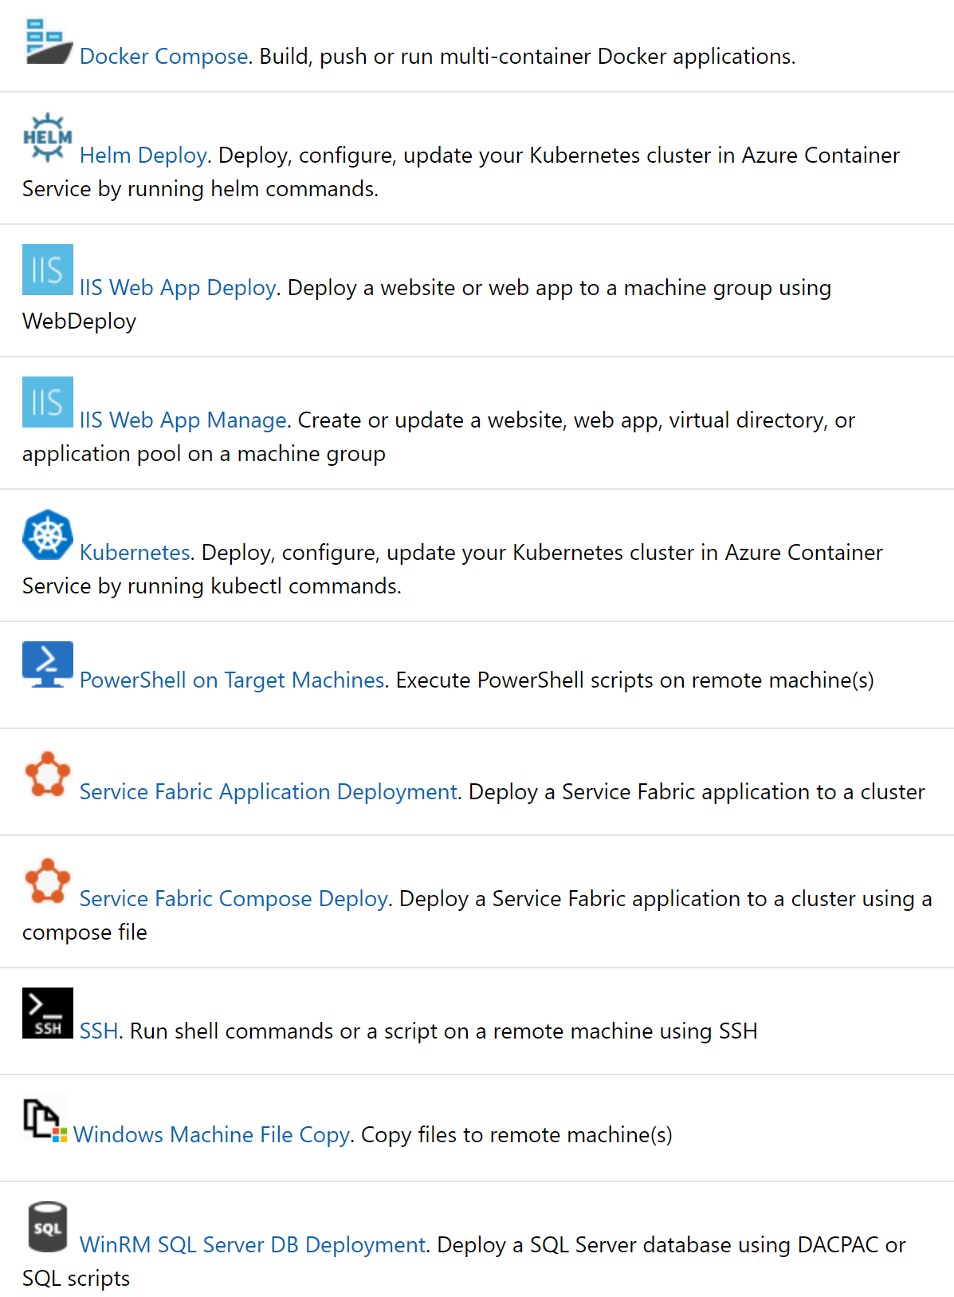
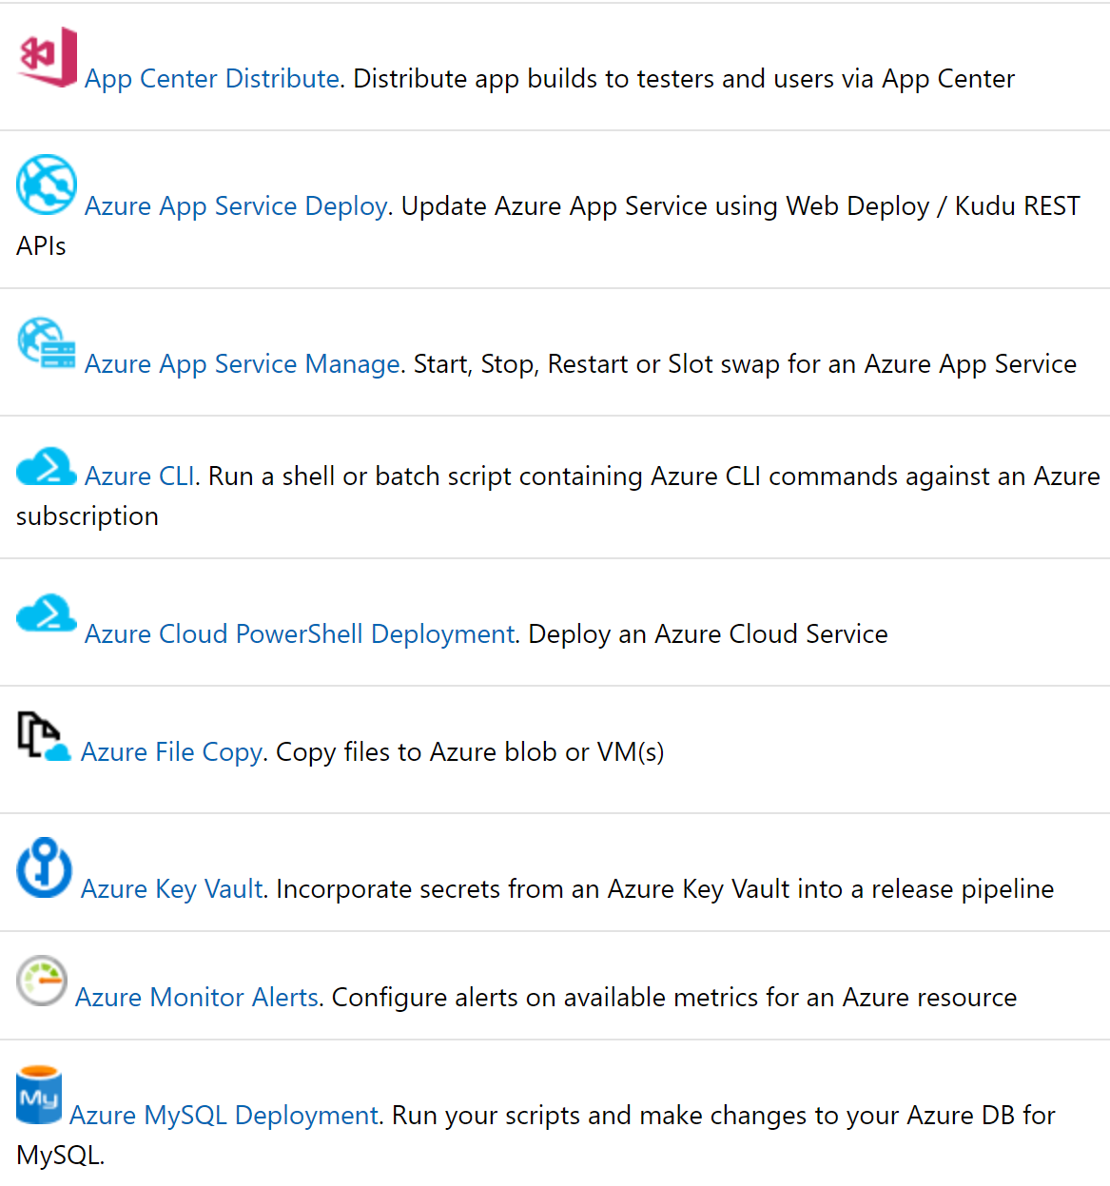
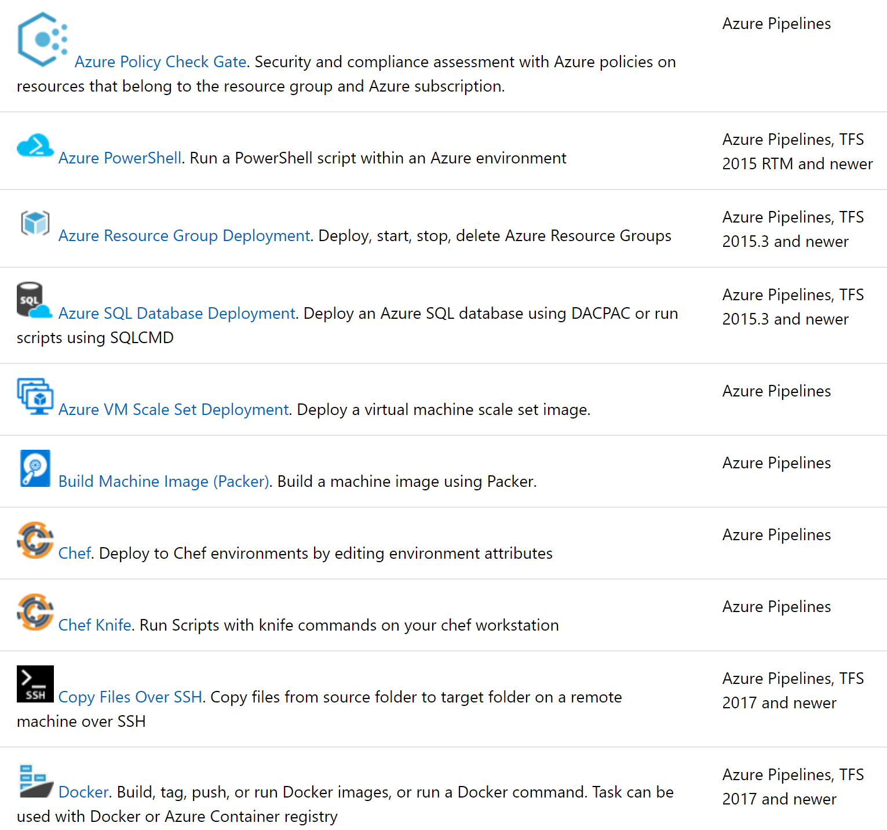
Important Deployment Tasks

Slide 80
Secrets in your release pipeline
Service Connections
Using secret variables
Storing secrets in a key vault
Retrieve with a variable group
Accessing Keyvault from within the pipeline

Slide 81
Release Gates
As a quality gate or as an automatic approval
Can be configured pre- and post stage
Keeps evaluating for success for a timeframe
Ships out of the box in Azure DevOps
Different types of Release Gate
Call an Azure Function
Call a REST API
Azure Monitor
Query Work Items
Publish to Azure Service Bus

Slide 82
Service Hooks
Service hooks enable you to perform tasks on other services when events happen
Out of the Box integrations
Build and release | Collaborate | Customer support | Plan and track | Integrate
AppVeyor | Campfire | UserVoice | Trello | Azure Service Bus
Bamboo | Flowdock | Zendesk |  | Azure Storage
Jenkins | HipChat |  |  | Web Hooks
MyGet | Hubot |  |  | Zapier
Slack

Slide 83
Introduction into Deployment Patterns

Slide 84

Definitions of microservices
Small and focused on doing one thing well
Autonomous
“Loosely coupled service oriented architecture with bounded contexts” Adrian Cockcroft (Netflix)
“… services are independently deployable and scalable, each service also provides a firm module boundary, even allowing for different services to be written in different programming languages.” Martin Fowler (Thoughtworks)
“SOA done right” Anonymous

Slide 85
Deployment Patterns
Dev
Test
Staging
Production
“Classical” Deployment Patterns

Slide 86
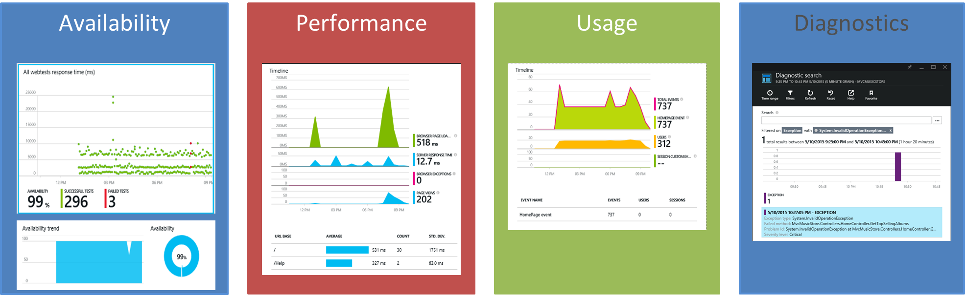
Feedback loops
Application Insights > Application Map

Slide 87



Blue Green deployment
www.production.com
Load Balancer
Swap
Blue
www.temp.production.com
Green

Slide 88
Feature toggles
What is it?
Mechanism to separate feature deployment from feature exposure
A.k.a. feature flippers, feature flags, feature switch, conditional feature, etc.
Why do you need it?
It enables you to give control back to the business on when to release the feature
Enables A/B testing, canary releases and dark launching
It provides an alternative to keeping multiple branches in version control
Enables change without redeployment

Slide 89

Canary release
What is it?
Releasing a feature to a limited subset of end users
Why do you need it?
Validates there is no break
When you want to gradually roll out a feature to ensure enough capacity

Slide 90
Canary release
How do you do it?
Use a combination of feature toggles, traffic routing and deployment slots
Random selection of users:
Setup deployment slots with feature enable
Route %traffic to the instance with the new feature enabled
Target specific user segment
Use feature toggle to enable feature for specific user segment

Slide 91
Traffic Manager
What is it?
Traffic manager provides the ability to route traffic between Azure app services
Within an app service, routes traffic between deployment slots
Why do you need it?
It enables failover and load distribution capabilities
It enables you to deploy to a slot and then slowly move traffic over to the other slot

Slide 92
Dark Launching
Dark Launching is in many ways similar to Canary Testing. However, the difference here is that you are looking to assess the response of users to new features in your frontend, rather than testing the performance of the backend. The idea is that rather than launch a new feature for all users, you instead release it to a small set of users. Usually, these users aren’t aware they are being used as guinea pigs for the new feature and often you don’t even highlight the new feature to them, hence the term “Dark” launching.

Slide 93
Infrastructure as Code and Configuration Management

Slide 94
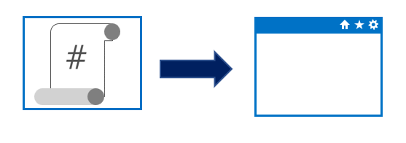

Imperative vs. Declarative
Approaches to implementing infrastructure and configuration as code
Declarative
Functional
Defines what the final state should be
Imperative
Procedural
Defines the “how” for what the final state should be
Notes:
Could mention that Imperative can also be known or called as procedural. And Declarative can sometimes be referred to as functional.
Declarative abstracts away the methodology of how a state is achieved.
A declarative approach would generally be the preferred option where ease of use is the main goal. Azure Resource Manager template files are an example of a declarative automation approach.
An imperative approach may have some advantages where there are complex scenarios where changes in the environment take place relatively frequently, which need to be accounted for in your code.
There is no absolute on which is the best approach to take, and individual tools may be able to be used in either declarative or imperative forms. The best approach for you to take will depend on your particular needs

Slide 95

Idempotence
Idempotence – definition
Mathematical term used in the context of infrastructure and configuration as code
Ability to apply one or more operations against a resource, resulting in the same outcome
To attain idempotence
Automatically configure and reconfigure an existing set of resources, or
Discard existing resources and spin up a fresh environment
Notes:
Idempotence – mathematical term used in the context of infrastructure and configuration as code, referring to the ability to apply one or more operations against a resource, resulting in the same outcome.
For more information about idempotence in general and in the context of Azure, see - https://www.wintellect.com/idempotency-for-windows-azure-message-queues/

Slide 96
Configuration Drift
Configuration drift
Process whereby a set of resources change their state over time
Can occur from changes made by people, processes, or programs
Potential security risks introduced by configuration drift
Open ports that should have been closed
Inconsistent patching across environments
Software that doesn’t meet compliance requirements
Solutions that can help
Windows PowerShell Desired State Configuration
Azure Policy
Many non-Microsoft solutions integrated with Azure

Slide 97



What is Azure Resource Manager?
Azure Resource Manager is a management layer in which a resource group and all the resources within it are created, configured, managed, and deleted
Azure Resource Manager: Management Layer
Azure PowerShell
Azure CLI
Azure Portal
REST APIs
Client SDKs
Notes:
Azure Resource Manager provides a consistent management layer that allows you automate deployment and configuration of resources, using different automation and scripting tools such as Microsoft Azure PowerShell, Azure Command-Line Interface (Azure CLI), Microsoft Azure portal, REST API, and client SDKs.

Slide 98
Why Use ARM templates?
Make deployments faster and more repeatable
Improve consistency by providing a common language
Enable you to deploy multiple resources in the correct order by mapping out resource dependencies
Reduce manual, error-prone tasks
Templates can be linked together to provide a modular solution
Notes:
Can discuss some of the benefits of using ARM templates when deploying and configuring resources in Azure.

Slide 99
What is Azure CLI?
Command-line program to connect to Azure
Execute administrative commands on Azure resources through a terminal, command-line prompt, or script, instead of a web browser
For example, to restart a VM use the command:
az vm restart -g MyResourceGroup -n MyVm
Can be installed on Linux, Mac, or Windows computers
Can be use interactively or scripted
Interactive: Issue commands directly at the shell prompt
Scripted: Assemble the CLI commands into a shell script and then execute the script
Notes:
The Azure CLI is a command-line program to connect to Azure and execute administrative commands on Azure resources. It runs on Linux, macOS, and Windows and allows administrators and developers to execute their commands through a terminal or command-line prompt (or script!) instead of a web browser.
Mention the cross-platform command-line tools support for managing Azure resources, as well as the ability to access the CLI from the Cloud Shell.

Slide 100
What is Azure PowerShell?
Module added to Windows PowerShell or PowerShell Core
Connect to your Azure subscription and manage resources
Adds the Azure-specific commands
Example: the NewAzVm command
New-AzVm ‘
-ResourceGroupName “CrmTesting ResourceGroup” ‘
-Name “CRMUnitTests” ‘
-Image “UbuntuLTS”
Azure PowerShell available either locally or via the Cloud Shell
Can be use in interactive or scripting mode

Slide 101
VM Extensions with PowerShell
Include Azure VM extensions with ARM templates for making configuration changes on already deployed VMs
To see a list of individual extensions:
Get-Command Set-*Extension* -Module Az.Compute
Example of a Custom Script Extension
Set-AzureRmVMCustomScriptExtension ` -ResourceGroupName "ResourceGroup11" ` -Location “Central US" -VMName "VirtualMachine07“` -Name "ContosoTest" –TypeHandlerVersion "1.1" ` -StorageAccountName "Contoso" `
-StorageAccountKey <StorageKey> `
-FileName "ContosoScript.exe"
-ContainerName "Scripts"
Notes:
Point out that the wild characters in the command are intentional and its use will return all cmdlets that contain the word “extension”, so they can all be viewed.
Also, point students to the Azure documentation from where the sample Custom Script Extension is taken.
Set-AzureRmVMCustomScriptExtension
https://docs.microsoft.com/en-us/powershell/module/azurerm.compute/set-azurermvmcustomscriptextension?view=azurermps-6.13.0#examples

Slide 102
Azure Cloud Shell
Cloud Shell hosted in the cloud and accessible via web browser and multiple access points including:
https://shell.azure.com
Directly via the Azure Portal,
Azure mobile app,
Visual Studio Code - Azure Account extension,
Authenticates automatically and securely with Azure
Can choose between Bash or PowerShell shell
Contains integrated script editor
Requires the creation of a storage account
Notes:
✔️ You might recommend the following video to students for viewing after class. It provides more details about Azure Cloud Shell. See Azure Friday – PowerShell in Azure Cloud Shell GA (https://azure.microsoft.com/en-us/resources/videos/azure-friday-powershell-in-azure-cloud-shell-ga/).

Slide 103
Azure Automation

Slide 104

What is Azure Automation?
An Automation service integrated with Microsoft Azure for automating the creation, deployment, monitoring and maintenance of Azure resources and resources external to Azure
Integration with Microsoft Azure remove some complexity of automating in Azure
Azure Automation Capabilities include:
Manage Shared resources
State configuration
Integration with GitHub, Azure DevOps Git/TFVC
Update management
Can automate Windows or Linux environments
Can apply to any system that exposes an API over internet protocols

Slide 105

Automation accounts
To use Azure Automation you must create an Azure Automation account
Automation account acts as a container in which you store, manage and use automation artifacts
Provides a way to separate your environments or further organize your Automation workflows and resources.
Requires subscription-owner level access as provides access to all Azure resources via an API
Need at least 1 but should have multiple for access control
Run As account
Can create when creating Azure Automation account
Creates a service principal user in Azure AD which allows access to Azure resources when running automation
Notes:
Could create Azure Automation accounts for dev, test, production, security, or other elements in your pipeline for more granular auditing, cost analysis and general management, as well as increased security.
When you create a Run As account, it creates a new service principal user in Azure Active Directory and assigns the Contributor role to this user at the subscription level

Slide 106
Infrastructure as a Service

Slide 107
Azure Virtual Machines
Azure VMs provide the benefits of virtualization, but must still be deployed, configured, and maintained
Operating system support for Windows and Linux OS deployments
Windows
Windows Server and Windows client images available in Azure Marketplace for development test and production
Images identified by publisher, offer, SKU, and version
Only 64-bit operating systems supported
Linux
Endorsed distributions available in Azure Marketplace
Additional Linux partner-products, such as Docker, Jenkins
Notes:
Mention how to find what Windows Server SKUs are available in different locations, using the Azure CLI example in the content, in this case West Europe. A similar query is shown for Linus RedHat SKUs in the West US region.
Call out the list of Linux endorsed distribution, and though not an extensive list you can point them to https://docs.microsoft.com/en-us/azure/virtual-machines/linux/endorsed-distros for a complete list of endorsed distributions with links to specific products.

Slide 108
Scaling Azure VMs
Use virtual machine scale sets (vmss) for managing a group of identical, load balanced VMs
Benefits of scale sets
Create and manage multiple VMs at large scale
Provide high availability and application resiliency
Automatically scale as resource demand fluctuates
Options to configure VMs deployed in a scale set
Use extensions to configure a VM post deployment
Deploy a managed disk with a custom disk image
Differences between VMs and scale sets
Scale sets provide automated versus manual creation, configuration, and integration for different scenarios
Notes:
Discuss some of the benefits of virtual machine scale sets for each of the scenarios in the table. When you have multiple VMs that must be deployed across Availability Zones or Availability Sets, or you need to control traffic where load balancer and gateway configuration is required, creating scale sets will be a significant benefit. In these scenarios, would you rather manually create and manage individual VMs, or automatically do this from a central configuration? Especially when you need to add more instances and ensure high availability.
Also, with scale sets, you can automatically scale out based on host metrics or things like Application Insights.
As with all quoted numbers related to service limits, quotas, and constraints, these can change over time.

Slide 109

Walkthrough-Create Virtual Machine Scale Set
Create a resource group and a virtual machine scale set.
Deploy a sample web application using a Custom Script Extension.
Create a load balancer rule to allow traffic to reach the sample application.
Access the sample web application and obtain the load balancer’s IP address:
Load balancer distributes traffic to one of your VM instances
Notes:
✔ You could have students do this walkthrough, but it may be easier to just demonstrate the procedure. That way if some students don’t already have a subscription, you avoid the issues associated with ensuring all students can meet the prerequisites to do the task.
The slide lists the individual steps only for the walkthrough, so you will need to cover the sample script in the content.
Mention the “good hygiene” of removing resources when no longer needed, using az group delete.

Slide 110
Windows Server and Hyper-V containers
Windows Server containers
Additional services in the OS for managing containers – the Docker engine and compute services
Each container uses same set of system processes, with a set of application process to distinguish each container
Hyper-V containers
Specifically optimized to run containers
More secure alternative to Windows Server containers in the event of a vulnerability in the OS from sharing kernel and memory
Nano Server
Headless deployment option for running cloud applications
Runs as a container in a container host such as Server Core
Notes:
Use the diagrams to highlight the differences in architecture between Windows Server and Hyper-V containers. While there are similarities, focus on Hyper-V’s containers’ more optimized, virtualized environment that allows a more secure container implementation.
Note that Hyper-V containers are supported now on both Windows Server 2016 and newer versions, and on the Windows 10 Anniversary edition.
Note the different scenario examples listed for Nano Server.

Slide 111

Azure DevTest Labs
Creates environments consisting of pre-configured bases or Azure Resource Manager templates
Enables developers on teams to efficiently self-manage virtual machines (VMs) and PaaS resources without waiting for approvals.
Quickly provision Windows and Linux environments by using reusable templates and artifacts
Usage Scenarios:
Dev or Test environments
Integrate with CI/CD pipeline for automated tests and deleting images afterwards
Scale up your load testing by provisioning multiple test agents and create pre-provisioned environments for training and demos

Slide 112

Azure App Service
Fully managed environment enabling high productivity development
Platform-as-a-service (PaaS) offering for building and deploying highly available and scalable cloud apps for web and mobile
Developer productivity using .NET, .NET Core, Java, Python and a host of others
Pay only for the compute resources used
Azure platform handles infrastructure so that developers focus on core web apps and services
Azure provides enterprise-grade security and compliance. Azure Active Directory
Notes:
✔ With App Service, you pay for the Azure compute resources you use. The compute resources you use is determined by the App Service plan that you run your Web Apps on.
For more information, you can see:
App Service - https://azure.microsoft.com/en-us/services/app-service/
While the slide provides a high-level look at App Service, focus on some of the DevOps capabilities, such as continuous deployment from Azure DevOps, GitHub, Docker Hub, and other sources.
Additionally, security and compliance is built-in with App Service being ISO, SOC, and PCI compliant. Authentication occurs through Azure AD, or through the appropriate API for the various social media services.

Slide 113
App Service Plans
Define a set of compute resources for a web app to run
One or more apps can be configured to run in the same App Service plan
App Service plans define:
Region where compute resources will be created (West US, East US, etc.)
Number of virtual machine instances (scale count.)
Instance size (Small, Medium, Large)
Pricing tier (next slide)
Notes:
Don’t spend too much time on this and the next slide (which goes into a little more detail on the different pricing tiers). Just introduce the concepts of an app service plan.
For more information, you can see:
Azure App Service plan overview - https://docs.microsoft.com/en-us/azure/app-service/azure-web-sites-web-hosting-plans-in-depth-overview

Slide 114

Azure Functions
Key features of Azure Functions
Choice of language
Pay-per-use pricing model
Support for NuGet and Node Package Manager
Integrated security with OAuth providers, such as Azure AD, Facebook, Microsoft Account, and others
Simplified integration with other Azure services and SaaS offerings
Options for code development and deployment (portal, continuous integration, GitHub, Azure DevOps Services, and more)
Functions runtime is open-source and available on GitHub
Notes:
Briefly cover the key Azure Function features as you’ve already covered the key attributes when discussing serverless computing… things like focus on code only and not underlying infrastructure, event driven, automatic scaling, charges billed only as used, and statelessness. Mention that Azure Functions are ideal when messages are being received for example, from an IoT solution, and can rapidly respond to the message/trigger.
The list of key features is not exhaustive, and you can see more information at https://docs.microsoft.com/en-us/azure/azure-functions/.
Mention that language support is dependent on the different versions of Azure Functions runtime, so be sure to check the documentation for the latest information – https://docs.microsoft.com/en-us/azure/azure-functions/supported-languages#languages-in-runtime-1x-and-2x
You can also point students to the Azure Serverless Computing Cookbook at https://azure.microsoft.com/en-us/resources/azure-serverless-computing-cookbook/, which is a downloadable guide to building serverless apps that is provided by Microsoft.

Slide 115
Batch services
Azure Batch – fully managed cloud service for job scheduling and compute resource management
Creates, manages, and scales a pool of compute nodes (VMs) to run largest, resource-intensive workloads.
Provides a job scheduler to submit jobs into the VM pool (or set of VM pools)
Requirements to run applications
Application (doesn’t need to be cloud aware)
Pool of VMs (Batch service creates, manages, and monitors the pool)
Job scheduler to define the tasks that make up the job
Location to store output, typically Blob storage
Notes:
Azure Batch is ideal for running batch processing automated tasks that are composed of large-scale jobs. This can be done on demand so is an excellent option when you need to run large scale batch processing in the cloud, without having to worry about predefining a schedule.
Essentially, it enables the breaking down of computationally intensive workloads into individual tasks and you get the benefits of efficiently running those tasks in parallel at scale.

Slide 116
Security and Compliance in the Pipeline

Slide 117

Secure DevOps Kit for Azure (AzSK)
AzSK is a collection of scripts, tools, extensions, automations
Helps secure the subscription
Enables secure development
Integrates security into CI/CD
Provides continuous assurance
Assists with alerts & monitoring
Governing cloud risks
Available at:
https://github.com/azsk/DevOpsKit-docs
Notes:
Consider going to the github site, https://github.com/azsk/DevOpsKit-docs, and showing the readme to call out some elements of the AzSK

Slide 118

Azure Security Center
Provide security recommendations
Monitor security settings
Monitor all your services
Use Azure Machine Learning
Analyze and identify potential attacks
Provide just-in-time (JIT) access control
Supports Windows and Linux operating systems
Available in two pricing tiers

Slide 119

Azure Policy
Is a service in Azure that you use to create, assign, and, manage policies
Provides enforcement by using policies and initiatives
Runs evaluations on your resources and scans for those not compliant
Comes with several built-in policy and initiative definitions
Integrates with Azure DevOps by applying any continuous integration (CI) and continuous deployment (CD) pipeline policies
✔️ An example of an Azure policy that you can integrate with your DevOps pipeline is the Check Gate task
Notes:
Azure Policy Check Gate - https://docs.microsoft.com/en-us/azure/devops/pipelines/tasks/deploy/azure-policy-check-gate?view=vsts

Slide 120

Azure Key Vault
Usage scenarios
Secrets management
Key management
Certificate management
Hardware security modules
Benefits
Centralized application secrets
Securely stored secrets and keys
Monitor access and use
Simplified administration of application secrets
Integrate with other Azure services
Centralized cloud service for storing your applications' secrets

Slide 121

Role-Based Access Control (RBAC)
Segregate duties within your team and grant only the amount of access to users that they need to perform their jobs
Fine-grained access management for Azure resources
Grant users the lowest privilege level that they need to do their work
No additional cost to all Azure subscribers
Built-in roles for an allow model
Notes:
Examples of when you might use RBAC include when you want to:
Allow one user to manage VMs in a subscription, and another user to manage virtual networks.
Allow a database administrator (DBA) group to manage SQL Server databases in a subscription.
Allow a user to manage all resources in a resource group, such as VMs, websites, and subnets.
Allow an application to access all resources in a resource group.

Slide 122

Locks
Prevent accidental deletion or modification of your Azure resources
CanNotDelete - means authorized users can still read and modify a resource, but they can't delete the resource
ReadOnly - means authorized users can read a resource, but they can't delete or update it. Applying this lock is like restricting all authorized users to the permissions granted by the Reader role
In the Azure portal, the locks are called Delete and Read-only respectively

Slide 123

Azure Blueprints
Allows for the definition of a repeatable set of Azure resources that implement and adhere to an organization's standards, patterns, and requirements
Can ensure a deployment meets an organization's standards, patterns, and requirements.
Is a declarative way to orchestrate deployment for various resource templates and other artifacts
Provides for traceability and auditing as well as adherence
1
2
3
Create an Azure blueprint
Assign the blueprint
Track the blueprint assignments
The blueprint definition (what should be deployed) and the blueprint assignment (what is deployed) supports improved deployment tracking and auditing
Discussion: How to Azure Blueprint policies differ from templates?
Notes:
Azure Blueprints is also useful in Azure DevOps scenarios where blueprints are associated with specific build artifacts and release pipelines, and can be tracked more rigorously.
Note: At the time of writing, Azure Blueprints is in preview and has not yet been released publicly.
Discussion: How to Azure Blueprint policies differ from templates?
Answer:
The blueprints in Azure Blueprints are different from Azure Resource Manager templates. When Azure Resource Manager templates deploy resources, they have no active relationship with the deployed resources (they exist in a local environment or in source control). By contrast, with Azure Blueprints, each deployment is tied to an Azure Blueprints package. This means that the relationship with resources will be maintained, even after deployment. In this way, maintaining relationships improves auditing and tracking capabilities.

Slide 124
AZ-400.4 Module 1: Designing a Dependency Management Strategy

Slide 125
Dependencies in software
Modern software is complex
Component based development is common
Not all software is written by a single team
Dependencies on components created by other teams or persons

Slide 126
What is a package?
Mechanism to create, share and consume code and components
Contains (compiled) code with metadata content for consuming packages

Slide 127





Types of packages
Microsoft platform and .NET artifacts
Node.js modules
Python scripts
Universal packages
Java packages
Docker images
NuGet Microsoft development platform and .NET artifacts
Npm node.js modules
Maven Java packages
Python Python script
Universal Set of related files
Docker Container images
Symbols Symbol files

Slide 128
Package feeds
Centralized storage of package artifacts
Public or privately available
Offer secure access for private feeds
Versioned storage of packages
Managed by tooling
Also known as
Package repositories
Package registry

Slide 129
Private and public feeds
Public
NuGet.org
Npmjs.org
PyPi.org
Docker Hub
Private feeds
MyGet
Azure Container Registry
Azure Artifacts
Self-hosted solution

Slide 130
Public sources
NuGet Gallery https://nuget.org
NPMjs https://npmjs.org
Maven https://search.maven.org
Docker Hub https://hub.docker.com
Python Package Index https://pypi.org

Slide 131

Azure Artifacts
Part of Azure DevOps
Create private and public package feeds
Types of packages supported
NuGet
NPM
Maven
Universal
Python

Slide 132


Integrating in build pipelines
Why integrate in build pipeline?
Automate to avoid errors
Quality checks
Implement a versioning strategy

Slide 133

Azure Pipelines tasks
Different tasks for each of the package types
Native integration with Azure Artifacts feeds
Connecting with remote packages sources possible
Requires authentication

Slide 134

Semantic versioning
Express nature and risk of change
See also: https://semver.org

Slide 135
Practices to Measure End-User Satisfaction

Slide 136
Design Practices to Measure End-User Satisfaction
Outline your goals and plan.
Create a customer satisfaction survey.
Choose your survey’s trigger and timing.
Analyze the survey data.
Make adjustments and repeat.

Slide 137
Tools to Track System Usage, Feature Usage, and Flow

Slide 138


Slide 139
App Center Diagnostics
App Center Diagnostics is a cloud service that helps developers monitor the health of an application, delivering the data needed to understand what happens when an app fails during testing or in the wild.
In the App Center Diagnostics UI, you can attach, view and download one binary and one test attachment to your crash reports.
Track events leading up to a crash to capture useful information about the state of your app.

Slide 140

Azure Dashboards

Slide 141
Infrastructure as Code as Containers

Slide 142

Containers vs. VMs
timw.info/nac
Notes:
Could mention that Imperative can also be known or called as procedural. And Declarative can sometimes be referred to as functional.
Declarative abstracts away the methodology of how a state is achieved.
A declarative approach would generally be the preferred option where ease of use is the main goal. Azure Resource Manager template files are an example of a declarative automation approach.
An imperative approach may have some advantages where there are complex scenarios where changes in the environment take place relatively frequently, which need to be accounted for in your code.
There is no absolute on which is the best approach to take, and individual tools may be able to be used in either declarative or imperative forms. The best approach for you to take will depend on your particular needs

Slide 143

Docker Container Build and Deployment Workflow
timw.info/dcw2
Notes:
Could mention that Imperative can also be known or called as procedural. And Declarative can sometimes be referred to as functional.
Declarative abstracts away the methodology of how a state is achieved.
A declarative approach would generally be the preferred option where ease of use is the main goal. Azure Resource Manager template files are an example of a declarative automation approach.
An imperative approach may have some advantages where there are complex scenarios where changes in the environment take place relatively frequently, which need to be accounted for in your code.
There is no absolute on which is the best approach to take, and individual tools may be able to be used in either declarative or imperative forms. The best approach for you to take will depend on your particular needs

Slide 144

Single-Stage Image Builds
Multiple dockerfiles/images for different environments
Larger storage footprint/attack surface
More management
timw.info/msdb
Notes:
Could mention that Imperative can also be known or called as procedural. And Declarative can sometimes be referred to as functional.
Declarative abstracts away the methodology of how a state is achieved.
A declarative approach would generally be the preferred option where ease of use is the main goal. Azure Resource Manager template files are an example of a declarative automation approach.
An imperative approach may have some advantages where there are complex scenarios where changes in the environment take place relatively frequently, which need to be accounted for in your code.
There is no absolute on which is the best approach to take, and individual tools may be able to be used in either declarative or imperative forms. The best approach for you to take will depend on your particular needs

Slide 145

Multi-Stage Image Builds
Similar pattern to multi-stage YAML pipeline
Copy elements from one image to another
Slimmer/more secure images
timw.info/msdb
Notes:
Could mention that Imperative can also be known or called as procedural. And Declarative can sometimes be referred to as functional.
Declarative abstracts away the methodology of how a state is achieved.
A declarative approach would generally be the preferred option where ease of use is the main goal. Azure Resource Manager template files are an example of a declarative automation approach.
An imperative approach may have some advantages where there are complex scenarios where changes in the environment take place relatively frequently, which need to be accounted for in your code.
There is no absolute on which is the best approach to take, and individual tools may be able to be used in either declarative or imperative forms. The best approach for you to take will depend on your particular needs

Slide 146
Azure Support for Containers
Azure Container Registry
Azure Container Instance
Azure Kubernetes Service (AKS)
timw.info/sadf
Notes:
Could mention that Imperative can also be known or called as procedural. And Declarative can sometimes be referred to as functional.
Declarative abstracts away the methodology of how a state is achieved.
A declarative approach would generally be the preferred option where ease of use is the main goal. Azure Resource Manager template files are an example of a declarative automation approach.
An imperative approach may have some advantages where there are complex scenarios where changes in the environment take place relatively frequently, which need to be accounted for in your code.
There is no absolute on which is the best approach to take, and individual tools may be able to be used in either declarative or imperative forms. The best approach for you to take will depend on your particular needs

Slide 147

Azure DevOps Docker Build/Release Tasks
Notes:
Could mention that Imperative can also be known or called as procedural. And Declarative can sometimes be referred to as functional.
Declarative abstracts away the methodology of how a state is achieved.
A declarative approach would generally be the preferred option where ease of use is the main goal. Azure Resource Manager template files are an example of a declarative automation approach.
An imperative approach may have some advantages where there are complex scenarios where changes in the environment take place relatively frequently, which need to be accounted for in your code.
There is no absolute on which is the best approach to take, and individual tools may be able to be used in either declarative or imperative forms. The best approach for you to take will depend on your particular needs

Slide 148
Infrastructure as Code and Configuration Management

Slide 149
Imperative vs. Declarative
Approaches to implementing infrastructure and configuration as code
Declarative
Functional
Defines what the final state should be
Imperative
Procedural
Defines the “how” for what the final state should be
Notes:
Could mention that Imperative can also be known or called as procedural. And Declarative can sometimes be referred to as functional.
Declarative abstracts away the methodology of how a state is achieved.
A declarative approach would generally be the preferred option where ease of use is the main goal. Azure Resource Manager template files are an example of a declarative automation approach.
An imperative approach may have some advantages where there are complex scenarios where changes in the environment take place relatively frequently, which need to be accounted for in your code.
There is no absolute on which is the best approach to take, and individual tools may be able to be used in either declarative or imperative forms. The best approach for you to take will depend on your particular needs

Slide 150
Idempotence
Idempotence – definition
Mathematical term used in the context of infrastructure and configuration as code
Ability to apply one or more operations against a resource, resulting in the same outcome
To attain idempotence
Automatically configure and reconfigure an existing set of resources, or
Discard existing resources and spin up a fresh environment
Notes:
Idempotence – mathematical term used in the context of infrastructure and configuration as code, referring to the ability to apply one or more operations against a resource, resulting in the same outcome.
For more information about idempotence in general and in the context of Azure, see - https://www.wintellect.com/idempotency-for-windows-azure-message-queues/

Slide 151
Configuration Drift
Configuration drift
Process whereby a set of resources change their state over time
Can occur from changes made by people, processes, or programs
Potential security risks introduced by configuration drift
Open ports that should have been closed
Inconsistent patching across environments
Software that doesn’t meet compliance requirements
Solutions that can help
Windows PowerShell Desired State Configuration
Azure Policy
Many non-Microsoft solutions integrated with Azure

Slide 152
What is Azure Resource Manager?
Azure Resource Manager is a management layer in which a resource group and all the resources within it are created, configured, managed, and deleted
Azure Resource Manager: Management Layer
Azure PowerShell
Azure CLI
Azure Portal
REST APIs
Client SDKs
Notes:
Azure Resource Manager provides a consistent management layer that allows you automate deployment and configuration of resources, using different automation and scripting tools such as Microsoft Azure PowerShell, Azure Command-Line Interface (Azure CLI), Microsoft Azure portal, REST API, and client SDKs.

Slide 153
Why Use ARM templates?
Make deployments faster and more repeatable
Improve consistency by providing a common language
Enable you to deploy multiple resources in the correct order by mapping out resource dependencies
Reduce manual, error-prone tasks
Templates can be linked together to provide a modular solution
Notes:
Can discuss some of the benefits of using ARM templates when deploying and configuring resources in Azure.

Slide 154
What is Azure CLI?
Command-line program to connect to Azure
Execute administrative commands on Azure resources through a terminal, command-line prompt, or script, instead of a web browser
For example, to restart a VM use the command:
az vm restart -g MyResourceGroup -n MyVm
Can be installed on Linux, Mac, or Windows computers
Can be use interactively or scripted
Interactive: Issue commands directly at the shell prompt
Scripted: Assemble the CLI commands into a shell script and then execute the script
Notes:
The Azure CLI is a command-line program to connect to Azure and execute administrative commands on Azure resources. It runs on Linux, macOS, and Windows and allows administrators and developers to execute their commands through a terminal or command-line prompt (or script!) instead of a web browser.
Mention the cross-platform command-line tools support for managing Azure resources, as well as the ability to access the CLI from the Cloud Shell.

Slide 155
What is Azure PowerShell?
Module added to Windows PowerShell or PowerShell Core
Connect to your Azure subscription and manage resources
Adds the Azure-specific commands
Example: the NewAzVm command
New-AzVm ‘
-ResourceGroupName “CrmTesting ResourceGroup” ‘
-Name “CRMUnitTests” ‘
-Image “UbuntuLTS”
Azure PowerShell available either locally or via the Cloud Shell
Can be use in interactive or scripting mode

Slide 156
VM Extensions with PowerShell
Include Azure VM extensions with ARM templates for making configuration changes on already deployed VMs
To see a list of individual extensions:
Get-Command Set-*Extension* -Module Az.Compute
Example of a Custom Script Extension
Set-AzureRmVMCustomScriptExtension ` -ResourceGroupName "ResourceGroup11" ` -Location “Central US" -VMName "VirtualMachine07“` -Name "ContosoTest" –TypeHandlerVersion "1.1" ` -StorageAccountName "Contoso" `
-StorageAccountKey <StorageKey> `
-FileName "ContosoScript.exe"
-ContainerName "Scripts"
Notes:
Point out that the wild characters in the command are intentional and its use will return all cmdlets that contain the word “extension”, so they can all be viewed.
Also, point students to the Azure documentation from where the sample Custom Script Extension is taken.
Set-AzureRmVMCustomScriptExtension
https://docs.microsoft.com/en-us/powershell/module/azurerm.compute/set-azurermvmcustomscriptextension?view=azurermps-6.13.0#examples

Slide 157
Azure Cloud Shell
Cloud Shell hosted in the cloud and accessible via web browser and multiple access points including:
https://shell.azure.com
Directly via the Azure Portal,
Azure mobile app,
Visual Studio Code - Azure Account extension,
Authenticates automatically and securely with Azure
Can choose between Bash or PowerShell shell
Contains integrated script editor
Requires the creation of a storage account
Notes:
✔️ You might recommend the following video to students for viewing after class. It provides more details about Azure Cloud Shell. See Azure Friday – PowerShell in Azure Cloud Shell GA (https://azure.microsoft.com/en-us/resources/videos/azure-friday-powershell-in-azure-cloud-shell-ga/).

Slide 158
Azure Automation

Slide 159
What is Azure Automation?
An Automation service integrated with Microsoft Azure for automating the creation, deployment, monitoring and maintenance of Azure resources and resources external to Azure
Integration with Microsoft Azure remove some complexity of automating in Azure
Azure Automation Capabilities include:
Manage Shared resources
State configuration
Integration with GitHub, Azure DevOps Git/TFVC
Update management
Can automate Windows or Linux environments
Can apply to any system that exposes an API over internet protocols

Slide 160
Automation accounts
To use Azure Automation you must create an Azure Automation account
Automation account acts as a container in which you store, manage and use automation artifacts
Provides a way to separate your environments or further organize your Automation workflows and resources.
Requires subscription-owner level access as provides access to all Azure resources via an API
Need at least 1 but should have multiple for access control
Run As account
Can create when creating Azure Automation account
Creates a service principal user in Azure AD which allows access to Azure resources when running automation
Notes:
Could create Azure Automation accounts for dev, test, production, security, or other elements in your pipeline for more granular auditing, cost analysis and general management, as well as increased security.
When you create a Run As account, it creates a new service principal user in Azure Active Directory and assigns the Contributor role to this user at the subscription level

Slide 161
Infrastructure as a Service

Slide 162
Azure Virtual Machines
Azure VMs provide the benefits of virtualization, but must still be deployed, configured, and maintained
Operating system support for Windows and Linux OS deployments
Windows
Windows Server and Windows client images available in Azure Marketplace for development test and production
Images identified by publisher, offer, SKU, and version
Only 64-bit operating systems supported
Linux
Endorsed distributions available in Azure Marketplace
Additional Linux partner-products, such as Docker, Jenkins
Notes:
Mention how to find what Windows Server SKUs are available in different locations, using the Azure CLI example in the content, in this case West Europe. A similar query is shown for Linus RedHat SKUs in the West US region.
Call out the list of Linux endorsed distribution, and though not an extensive list you can point them to https://docs.microsoft.com/en-us/azure/virtual-machines/linux/endorsed-distros for a complete list of endorsed distributions with links to specific products.

Slide 163
Scaling Azure VMs
Use virtual machine scale sets (vmss) for managing a group of identical, load balanced VMs
Benefits of scale sets
Create and manage multiple VMs at large scale
Provide high availability and application resiliency
Automatically scale as resource demand fluctuates
Options to configure VMs deployed in a scale set
Use extensions to configure a VM post deployment
Deploy a managed disk with a custom disk image
Differences between VMs and scale sets
Scale sets provide automated versus manual creation, configuration, and integration for different scenarios
Notes:
Discuss some of the benefits of virtual machine scale sets for each of the scenarios in the table. When you have multiple VMs that must be deployed across Availability Zones or Availability Sets, or you need to control traffic where load balancer and gateway configuration is required, creating scale sets will be a significant benefit. In these scenarios, would you rather manually create and manage individual VMs, or automatically do this from a central configuration? Especially when you need to add more instances and ensure high availability.
Also, with scale sets, you can automatically scale out based on host metrics or things like Application Insights.
As with all quoted numbers related to service limits, quotas, and constraints, these can change over time.

Slide 164
Walkthrough-Create Virtual Machine Scale Set
Create a resource group and a virtual machine scale set.
Deploy a sample web application using a Custom Script Extension.
Create a load balancer rule to allow traffic to reach the sample application.
Access the sample web application and obtain the load balancer’s IP address:
Load balancer distributes traffic to one of your VM instances
Notes:
✔ You could have students do this walkthrough, but it may be easier to just demonstrate the procedure. That way if some students don’t already have a subscription, you avoid the issues associated with ensuring all students can meet the prerequisites to do the task.
The slide lists the individual steps only for the walkthrough, so you will need to cover the sample script in the content.
Mention the “good hygiene” of removing resources when no longer needed, using az group delete.

Slide 165
Windows Server and Hyper-V containers
Windows Server containers
Additional services in the OS for managing containers – the Docker engine and compute services
Each container uses same set of system processes, with a set of application process to distinguish each container
Hyper-V containers
Specifically optimized to run containers
More secure alternative to Windows Server containers in the event of a vulnerability in the OS from sharing kernel and memory
Nano Server
Headless deployment option for running cloud applications
Runs as a container in a container host such as Server Core
Notes:
Use the diagrams to highlight the differences in architecture between Windows Server and Hyper-V containers. While there are similarities, focus on Hyper-V’s containers’ more optimized, virtualized environment that allows a more secure container implementation.
Note that Hyper-V containers are supported now on both Windows Server 2016 and newer versions, and on the Windows 10 Anniversary edition.
Note the different scenario examples listed for Nano Server.

Slide 166
Azure DevTest Labs
Creates environments consisting of pre-configured bases or Azure Resource Manager templates
Enables developers on teams to efficiently self-manage virtual machines (VMs) and PaaS resources without waiting for approvals.
Quickly provision Windows and Linux environments by using reusable templates and artifacts
Usage Scenarios:
Dev or Test environments
Integrate with CI/CD pipeline for automated tests and deleting images afterwards
Scale up your load testing by provisioning multiple test agents and create pre-provisioned environments for training and demos

Slide 167
Azure App Service
Fully managed environment enabling high productivity development
Platform-as-a-service (PaaS) offering for building and deploying highly available and scalable cloud apps for web and mobile
Developer productivity using .NET, .NET Core, Java, Python and a host of others
Pay only for the compute resources used
Azure platform handles infrastructure so that developers focus on core web apps and services
Azure provides enterprise-grade security and compliance. Azure Active Directory
Notes:
✔ With App Service, you pay for the Azure compute resources you use. The compute resources you use is determined by the App Service plan that you run your Web Apps on.
For more information, you can see:
App Service - https://azure.microsoft.com/en-us/services/app-service/
While the slide provides a high-level look at App Service, focus on some of the DevOps capabilities, such as continuous deployment from Azure DevOps, GitHub, Docker Hub, and other sources.
Additionally, security and compliance is built-in with App Service being ISO, SOC, and PCI compliant. Authentication occurs through Azure AD, or through the appropriate API for the various social media services.

Slide 168
App Service Plans
Define a set of compute resources for a web app to run
One or more apps can be configured to run in the same App Service plan
App Service plans define:
Region where compute resources will be created (West US, East US, etc.)
Number of virtual machine instances (scale count.)
Instance size (Small, Medium, Large)
Pricing tier (next slide)
Notes:
Don’t spend too much time on this and the next slide (which goes into a little more detail on the different pricing tiers). Just introduce the concepts of an app service plan.
For more information, you can see:
Azure App Service plan overview - https://docs.microsoft.com/en-us/azure/app-service/azure-web-sites-web-hosting-plans-in-depth-overview

Slide 169
Azure Functions
Key features of Azure Functions
Choice of language
Pay-per-use pricing model
Support for NuGet and Node Package Manager
Integrated security with OAuth providers, such as Azure AD, Facebook, Microsoft Account, and others
Simplified integration with other Azure services and SaaS offerings
Options for code development and deployment (portal, continuous integration, GitHub, Azure DevOps Services, and more)
Functions runtime is open-source and available on GitHub
Notes:
Briefly cover the key Azure Function features as you’ve already covered the key attributes when discussing serverless computing… things like focus on code only and not underlying infrastructure, event driven, automatic scaling, charges billed only as used, and statelessness. Mention that Azure Functions are ideal when messages are being received for example, from an IoT solution, and can rapidly respond to the message/trigger.
The list of key features is not exhaustive, and you can see more information at https://docs.microsoft.com/en-us/azure/azure-functions/.
Mention that language support is dependent on the different versions of Azure Functions runtime, so be sure to check the documentation for the latest information – https://docs.microsoft.com/en-us/azure/azure-functions/supported-languages#languages-in-runtime-1x-and-2x
You can also point students to the Azure Serverless Computing Cookbook at https://azure.microsoft.com/en-us/resources/azure-serverless-computing-cookbook/, which is a downloadable guide to building serverless apps that is provided by Microsoft.

Slide 170
Batch services
Azure Batch – fully managed cloud service for job scheduling and compute resource management
Creates, manages, and scales a pool of compute nodes (VMs) to run largest, resource-intensive workloads.
Provides a job scheduler to submit jobs into the VM pool (or set of VM pools)
Requirements to run applications
Application (doesn’t need to be cloud aware)
Pool of VMs (Batch service creates, manages, and monitors the pool)
Job scheduler to define the tasks that make up the job
Location to store output, typically Blob storage
Notes:
Azure Batch is ideal for running batch processing automated tasks that are composed of large-scale jobs. This can be done on demand so is an excellent option when you need to run large scale batch processing in the cloud, without having to worry about predefining a schedule.
Essentially, it enables the breaking down of computationally intensive workloads into individual tasks and you get the benefits of efficiently running those tasks in parallel at scale.

Slide 171
Security and Compliance in the Pipeline

Slide 172
Secure DevOps Kit for Azure (AzSK)
AzSK is a collection of scripts, tools, extensions, automations
Helps secure the subscription
Enables secure development
Integrates security into CI/CD
Provides continuous assurance
Assists with alerts & monitoring
Governing cloud risks
Available at:
https://github.com/azsk/DevOpsKit-docs
Notes:
Consider going to the github site, https://github.com/azsk/DevOpsKit-docs, and showing the readme to call out some elements of the AzSK

Slide 173
Azure Security Center
Provide security recommendations
Monitor security settings
Monitor all your services
Use Azure Machine Learning
Analyze and identify potential attacks
Provide just-in-time (JIT) access control
Supports Windows and Linux operating systems
Available in two pricing tiers

Slide 174
Azure Policy
Is a service in Azure that you use to create, assign, and, manage policies
Provides enforcement by using policies and initiatives
Runs evaluations on your resources and scans for those not compliant
Comes with several built-in policy and initiative definitions
Integrates with Azure DevOps by applying any continuous integration (CI) and continuous deployment (CD) pipeline policies
✔️ An example of an Azure policy that you can integrate with your DevOps pipeline is the Check Gate task
Notes:
Azure Policy Check Gate - https://docs.microsoft.com/en-us/azure/devops/pipelines/tasks/deploy/azure-policy-check-gate?view=vsts

Slide 175
Azure Key Vault
Usage scenarios
Secrets management
Key management
Certificate management
Hardware security modules
Benefits
Centralized application secrets
Securely stored secrets and keys
Monitor access and use
Simplified administration of application secrets
Integrate with other Azure services
Centralized cloud service for storing your applications' secrets

Slide 176
Role-Based Access Control (RBAC)
Segregate duties within your team and grant only the amount of access to users that they need to perform their jobs
Fine-grained access management for Azure resources
Grant users the lowest privilege level that they need to do their work
No additional cost to all Azure subscribers
Built-in roles for an allow model
Notes:
Examples of when you might use RBAC include when you want to:
Allow one user to manage VMs in a subscription, and another user to manage virtual networks.
Allow a database administrator (DBA) group to manage SQL Server databases in a subscription.
Allow a user to manage all resources in a resource group, such as VMs, websites, and subnets.
Allow an application to access all resources in a resource group.

Slide 177
Locks
Prevent accidental deletion or modification of your Azure resources
CanNotDelete - means authorized users can still read and modify a resource, but they can't delete the resource
ReadOnly - means authorized users can read a resource, but they can't delete or update it. Applying this lock is like restricting all authorized users to the permissions granted by the Reader role
In the Azure portal, the locks are called Delete and Read-only respectively

Slide 178
Azure Blueprints
Allows for the definition of a repeatable set of Azure resources that implement and adhere to an organization's standards, patterns, and requirements
Can ensure a deployment meets an organization's standards, patterns, and requirements.
Is a declarative way to orchestrate deployment for various resource templates and other artifacts
Provides for traceability and auditing as well as adherence
1
2
3
Create an Azure blueprint
Assign the blueprint
Track the blueprint assignments
The blueprint definition (what should be deployed) and the blueprint assignment (what is deployed) supports improved deployment tracking and auditing
Discussion: How to Azure Blueprint policies differ from templates?
Notes:
Azure Blueprints is also useful in Azure DevOps scenarios where blueprints are associated with specific build artifacts and release pipelines, and can be tracked more rigorously.
Note: At the time of writing, Azure Blueprints is in preview and has not yet been released publicly.
Discussion: How to Azure Blueprint policies differ from templates?
Answer:
The blueprints in Azure Blueprints are different from Azure Resource Manager templates. When Azure Resource Manager templates deploy resources, they have no active relationship with the deployed resources (they exist in a local environment or in source control). By contrast, with Azure Blueprints, each deployment is tied to an Azure Blueprints package. This means that the relationship with resources will be maintained, even after deployment. In this way, maintaining relationships improves auditing and tracking capabilities.

Slide 179
Exam AZ-400 Exam Strategy

Slide 180
Tim's Certification Study Pyramid
Interdependence
Content knowledge
Practical application
Test-taking skills

Slide 181
Preparing for Online Testing

Slide 182

Why Microsoft Online Testing?
COVID means Pearson VUE physical testing centers are unavailable
The Pearson OnVUE client has come a LONG way
I'll use online testing exclusively from now on

Slide 183

Pearson OnVUE System Requirements
Windows 10 / Windows 8.1
macOS High Sierra (10.13)
4 GB RAM
1024x768/16 resolution
1920x1080/32 recommended
Touchscreens are prohibited

Slide 184

Pearson OnVUE System Requirements
3 Mbps down/up network bandwidth
Mobile hotspot tethering is prohibited
Browsers:
IE 11, Edge, Chrome, Firefox, or Safari (latest versions)

Slide 185

Pearson OnVUE System Requirements
Webcam: 640x480/10 fps
Microphone: integrated
Headsets not allowed
Corporate VPNs, firewalls, and proxies will likely disrupt the delivery
Check with networking team first

Slide 186
Your Pre-Exam Checklist
Computer set up
Kill all tasks except for your browser
May need to use Task Manager or Activity Monitor
Additional monitors turned off
Mobile phone
ID

Slide 187
During the Exam
Keep your face in the webcam frame
Keep your hands away from your mouth
Ensure you aren't interrupted
Walled room
Door closed
No bio breaks are allowed

Slide 188


Slide 189


Slide 190


Slide 191


Slide 192


Slide 193


Slide 194




Slide 195



Slide 196



Slide 197


Slide 198


Slide 199


Slide 200
AZ-400 Exam Tips
Expect to see a lot of JSON, PowerShell, and Azure CLI
Expect NOT to see C# or JavaScript
It doesn't matter which exam order you use:
AZ-203
AZ-103/AZ-104
AZ-400
Perform due diligence in validating your environment for Microsoft online testing

Slide 201
Thank you!
Course materials: timw.info/az400
Twitter: @TechTrainerTim
Work: timw.info/ps
Web: TechTrainerTim.com

Slide 202
Exam AZ-400 Exam Strategy

Slide 203
Tim's Certification Study Pyramid
Interdependence
Content knowledge
Practical application
Test-taking skills

Slide 204
AZ-400 Item Types

Slide 205

Single Answer Multiple Choice

Slide 206

Multiple Answer Multiple Choice

Slide 207
Repeated Scenario
You need to move an Azure VM to another hardware host.
Solution: You redeploy the VM.
Does this solution meet the goal?
Yes
No

Slide 208
Repeated Scenario
You need to move an Azure VM to another hardware host.
Solution: You restart the VM.
Does this solution meet the goal?
Yes
No

Slide 209

Select and Place

Slide 210

Build List and Reorder

Slide 211

Active Screen/Fill in the Blank

Slide 212

Case Study

Slide 213






Performance-Based Lab

Slide 214
Preparing for Online Testing

Slide 215
Why Microsoft Online Testing?
COVID means Pearson VUE physical testing centers are unavailable
The Pearson OnVUE client has come a LONG way
I'll use online testing exclusively from now on

Slide 216
Pearson OnVUE System Requirements
Windows 10 / Windows 8.1
macOS High Sierra (10.13)
4 GB RAM
1024x768/16 resolution
1920x1080/32 recommended
Touchscreens are prohibited

Slide 217
Pearson OnVUE System Requirements
3 Mbps down/up network bandwidth
Mobile hotspot tethering is prohibited
Browsers:
IE 11, Edge, Chrome, Firefox, or Safari (latest versions)

Slide 218
Pearson OnVUE System Requirements
Webcam: 640x480/10 fps
Microphone: integrated
Headsets not allowed
Corporate VPNs, firewalls, and proxies will likely disrupt the delivery
Check with networking team first

Slide 219
Your Pre-Exam Checklist
Computer set up
Kill all tasks except for your browser
May need to use Task Manager or Activity Monitor
Additional monitors turned off
Mobile phone
ID

Slide 220
During the Exam
Keep your face in the webcam frame
Keep your hands away from your mouth
Ensure you aren't interrupted
Walled room
Door closed
No bio breaks are allowed

Slide 221
Demo
asdf

Slide 234
AZ-400 Exam Tips
Expect to see a lot of JSON, PowerShell, and Azure CLI
Expect NOT to see C# or JavaScript
It doesn't matter which exam order you use:
AZ-203
AZ-103/AZ-104
AZ-400
Perform due diligence in validating your environment for Microsoft online testing

Slide 235
Thank you!
Course materials: timw.info/az400
Twitter: @TechTrainerTim
Work: timw.info/ps
Web: TechTrainerTim.com

